Slide 1

Business Zone Ethernet Cancel Order Journey – User Guide
BT Wholesale Online
V2
LEGAL NOTICE: The information contained in this briefing is confidential information as per your terms and conditions with BT. Please do not forward, republish or permit unauthorised access. The content is accurate at the time of writing and is subject to change.

Slide 2
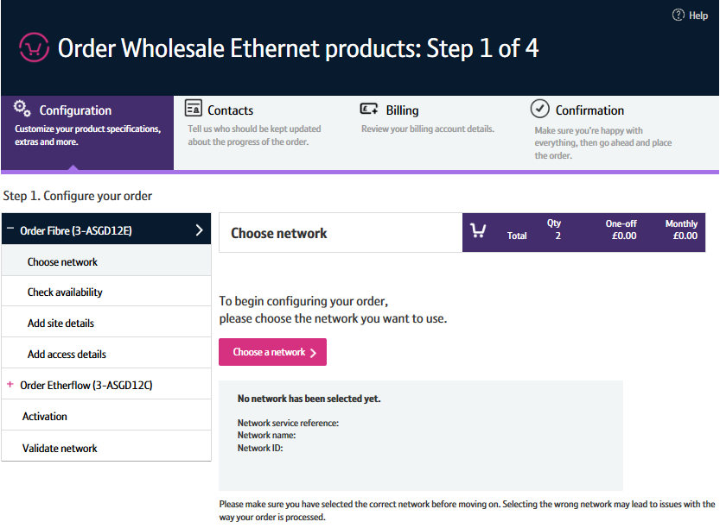
Contents
What’s in this User Guide?
p4 - Introduction
p5 - Available cancel order journeys
p6 - Pre-requisites
p7 - Layout
p8 - How do I cancel an order?
P16 - Important information
p17 - Contingency

Slide 3
Version Control
Date | Change | Version
21/12/16 | User Guide Published | 1
30/04/18 | Re-branded | 2

Slide 4
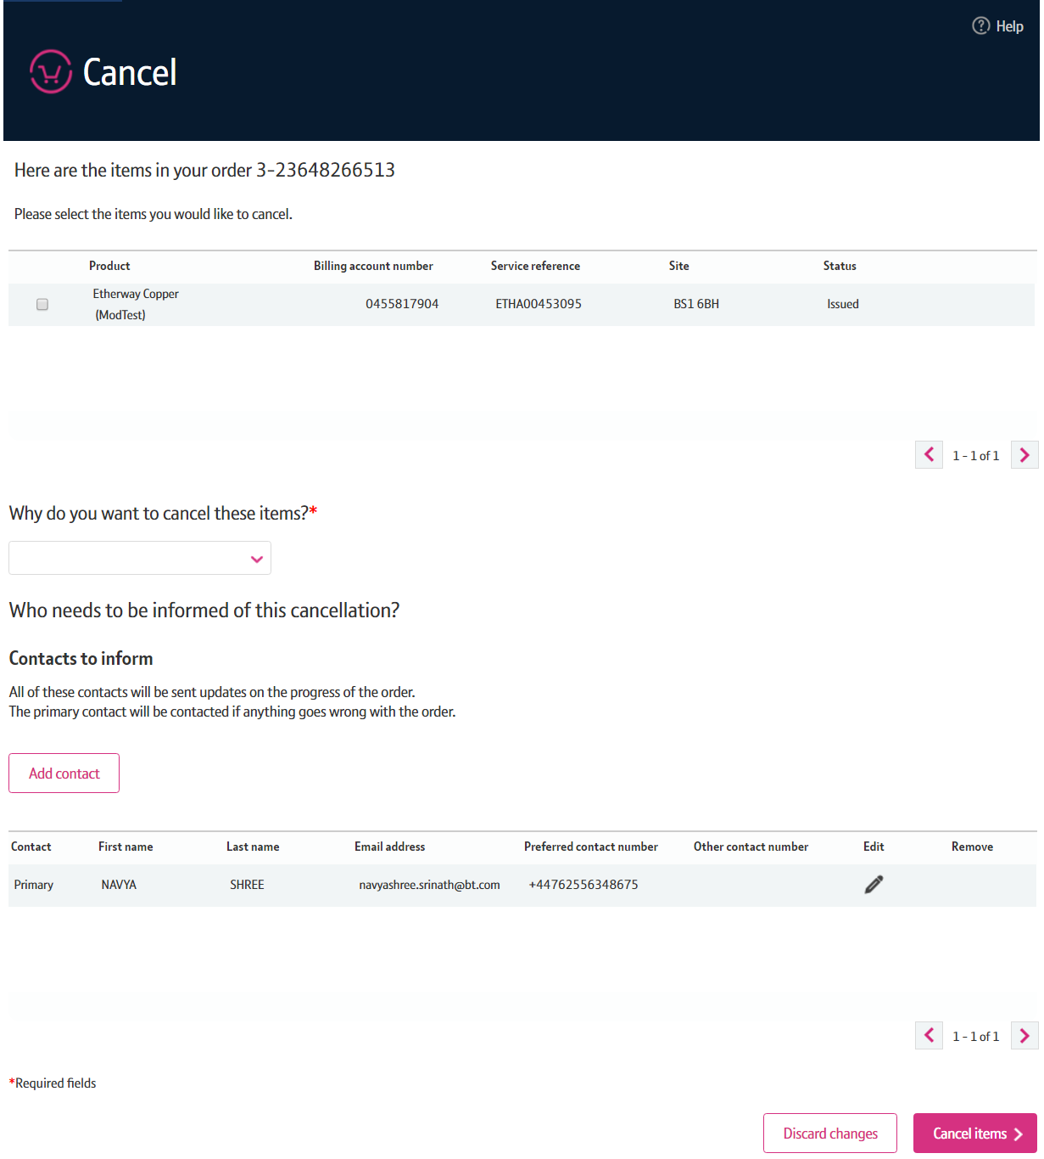
Introduction
What is the Ethernet Cancel Order Journey?
We’ve replaced the Eco Plus cancel order journey with a new improved view order journey for Ethernet.
Accessed via Business Zone, the new journey will allow you to make it easier to:
Cancel an order that’s in progress.
The new journey has improved navigation and layout, is compatible with modern browsers and easier to use than Eco Plus.

Slide 5
Pre-requisites
What do I need to access the new journey?
You need correct access and privileges, including Business Zone. If you don’t have this, please contact your company administrator to action
You must be using a Windows machine and using the latest version of Internet Explorer, Chrome or Firefox
Mobile devices, Mac and Safari are not supported

Slide 6
Layout
Select cancel item
        You need to select the item you want to cancel. To cancel an Etherway the associated Etherflow must be cancelled first.
Reason to cancel
        A reason must be provided for cancelling the order.
Discard changes
        The ‘Discard changes’ button allows you to reset any changes you’ve made prior to submitting the amend order.
1
2
3

Slide 7
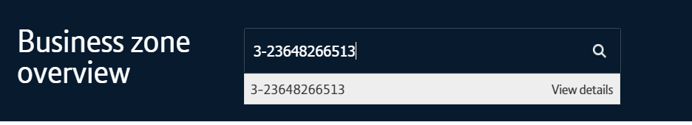
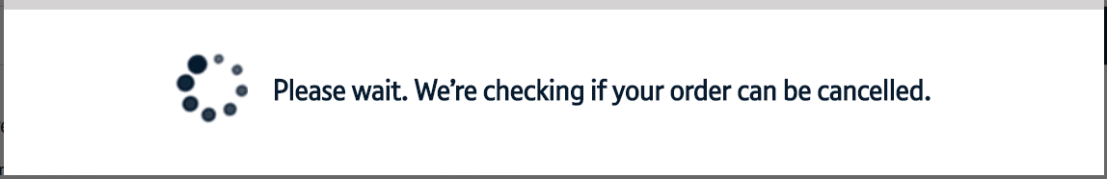
How do I cancel an order?
Search for your order
    First you’ll need to search for your order on My BT Wholesale. From here, you can instigate the cancellation.
Check to see if your order can be cancelled
        We’ll then need to check that your order can be cancelled. Depending on how far your order has progressed. If your order can’t be cancelled, we’ll tell you.
Tell us why you’re cancelling the order
        If your order can be cancelled, you’ll be taken to the cancellation journey. Here, you’ll need to tell us why you’re cancelling the order.
Cancellation charges
        There may be a charge depending on the item in your order.
Discarding the cancel order
        Once you’ve made your selection and continued to cancel those items you will not be able to go back and deselect those items. You will have to discard the changes and start your cancel order from the ‘View order’ screen.
1
2
3

Slide 8
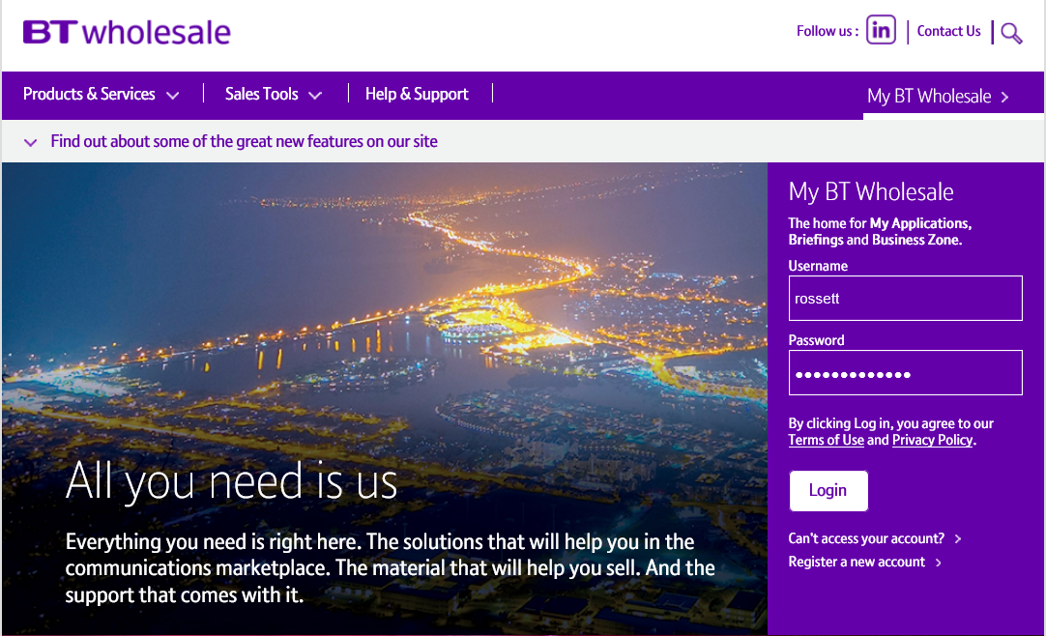
Searching for an order
Step 1: Logging In
Go to www.btwholesale.com
Enter your Username and Password
Click ‘Login’

Slide 9
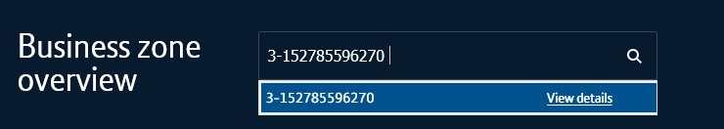
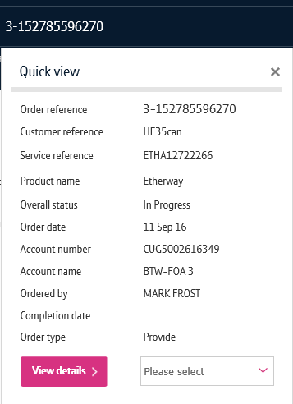
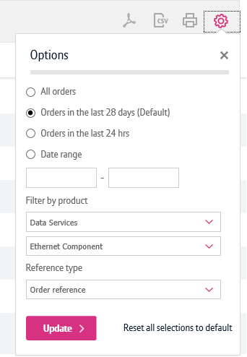
Searching for an order
Step 2: Searching
There’s a lot of different ways you can search for an order in My BT Wholesale. The easiest way is by entering your order reference in the search bar.
Click on the reference number to view the order quick view
You can also find the order by using the filters on the orders section of the Overview page and on My orders page.
1
2

Slide 10
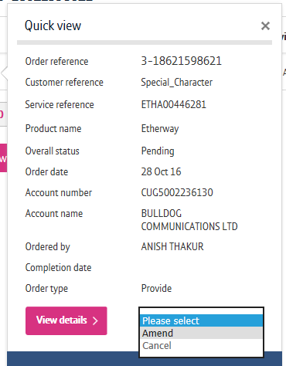
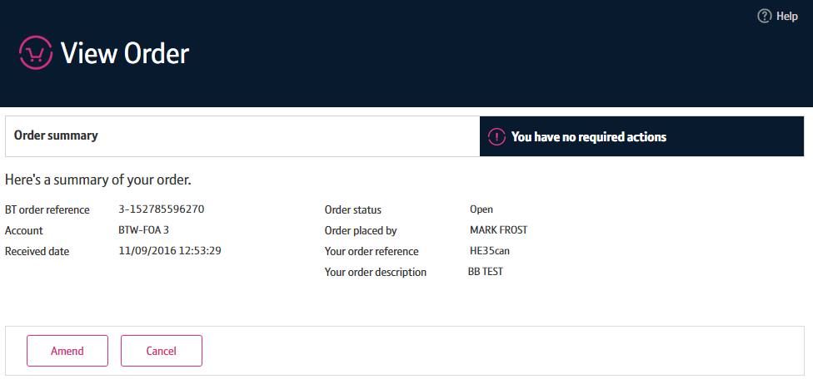
Initiate the cancel order
Once you’ve searched for your order, there’s two ways you can initiate the cancel order:
On the Quick View, you can select ‘Cancel’ from the dropdown
OR
You can click ‘Cancel’ from the ‘View Order’ screen.
1
2

Slide 11
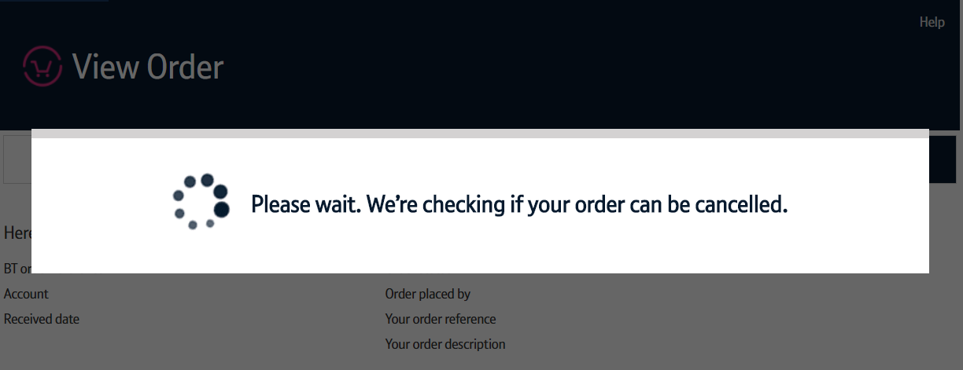
Initiate the cancel order
Once the cancel order has been initiated, a check will be carried out to see if the order can be cancelled.
If the order is past the point of when it can be cancelled (Point of no cancel or PONA for short), you’ll be taken to the ‘View Order’ screen.
Here, you’ll be told the order can’t be cancelled.
You can then click the ‘i’ icon next to the ordered component to learn why it can’t be cancelled.

Slide 12
Cancelling the order
You’ll now see the table of all items included in your order which you can select to cancel.
You will need to first select the items you wish to cancel.
To cancel the selected items, you will need to select a reason for cancelling from an option within the drop down.
You may add or amend the contacts within this order.
Click ‘Cancel items’ to proceed the cancellation.
Note: Once you’ve made your selection and continued to cancel those items you will not be able to go back and deselect those items. You will have to discard the changes and start your cancel order from the ‘View order’ screen.
1
2
3
4

Slide 13
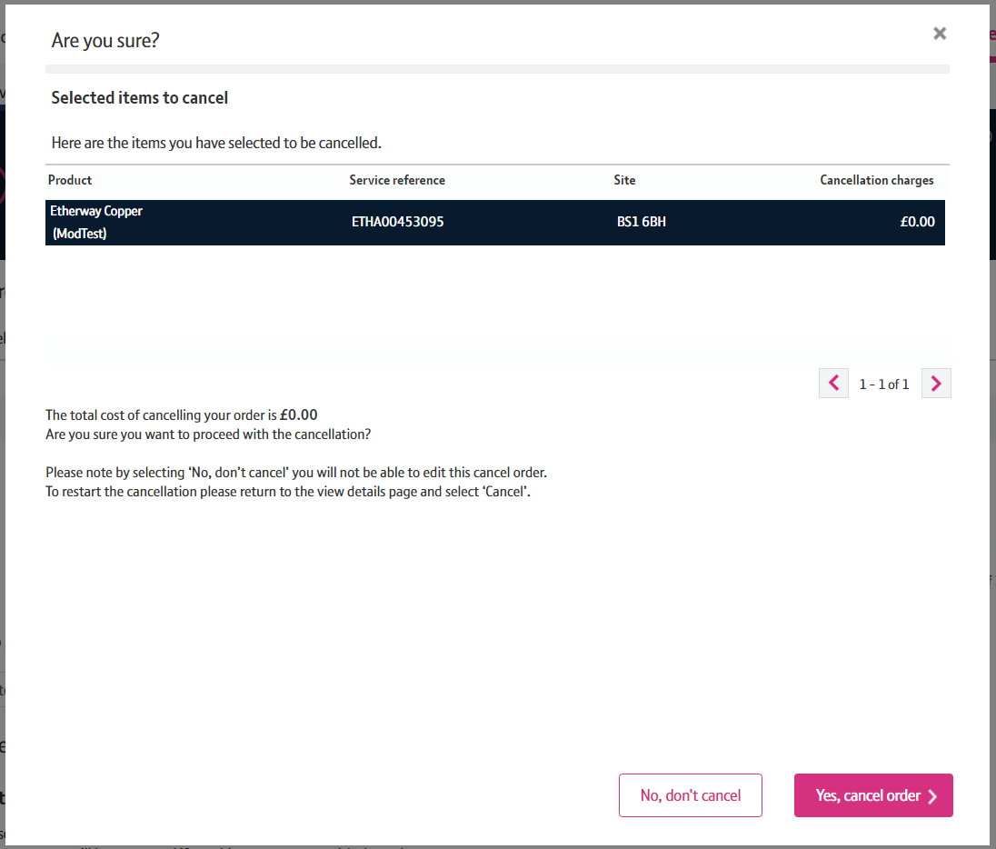
Cancelling the order
You’ll now be shown the cost associated with this cancellation depending on the item you have selected.
If you wish to continue with the cancelation select ‘Yes, cancel order’ button
If you wish to not continue the cancellation select ‘No, don’t cancel’ button
Note: Once you’ve made your selection and continued to cancel those items you will not be able to go back and deselect those items. You will have to discard the changes and start your cancel order from the ‘View order’ screen.
1
2

Slide 14
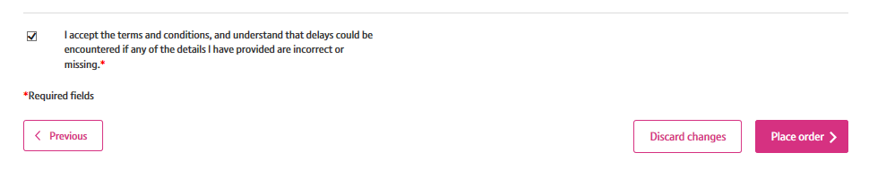
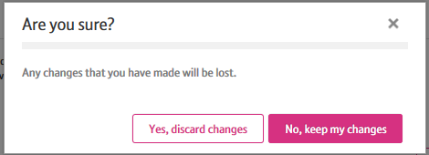
Discarding changes
If you want to reset the amendments you’ve made prior to placing your cancel order, you can do so by clicking the ‘Discard Changes’ button.
You’ll then need to confirm you wish to cancel the changes you’ve made by clicking ‘Yes, discard changes’.
Any changes you’ve made will be reset and you’ll be returned to the ‘View Order’ screen.
1
2

Slide 15
Important Information
All changes you make to your order must be compatible with the connecting Etherway, Etherflow and network. To learn more about this, please visit the Wholesale Ethernet Product Handbook. You’ll need to be logged in to access this.
Once you’ve started making changes to a component, you must proceed to each step of that order.

