Slide 1

Business Zone Ethernet Cease Order Journey – User Guide
BT Wholesale Online
V2
LEGAL NOTICE: The information contained in this briefing is confidential information as per your terms and conditions with BT. Please do not forward, republish or permit unauthorised access. The content is accurate at the time of writing and is subject to change.

Slide 2
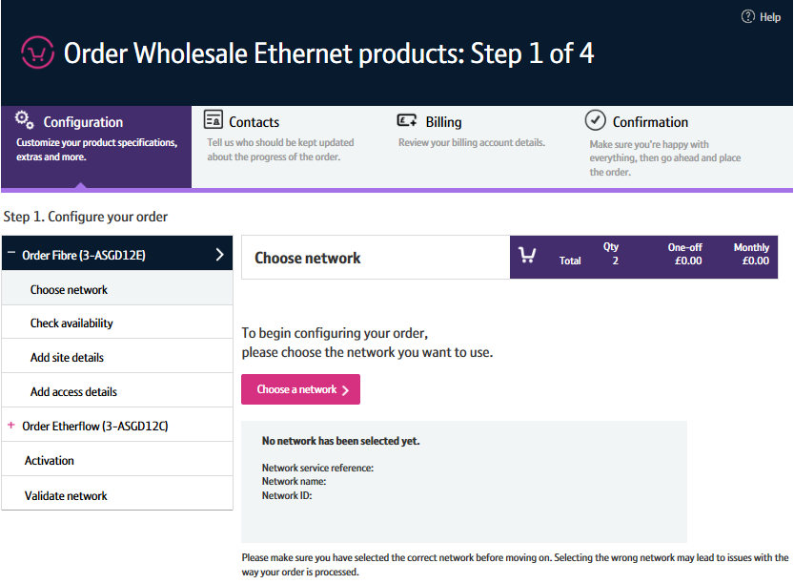
Contents
What’s in this User Guide?
p4 - Introduction
p5 - Which products is Cease asset available for?
p6 - The process
p7 - Before you start
p8 - Logging in
p9 - Searching for an asset
p10 - Starting the journey
p11 - Checking if you can cease the asset
p12 - Configuring your order
p13 - Validating your network
p14 - Check contacts
p15 - Billing
p16 - Confirmation
p17 - Order submitted
p18 - Discarding changes

Slide 3
Version Control
Date | Change | Version
01/05/17 | User Guide Published | 1
30/04/18 | Re-branded | 2

Slide 4
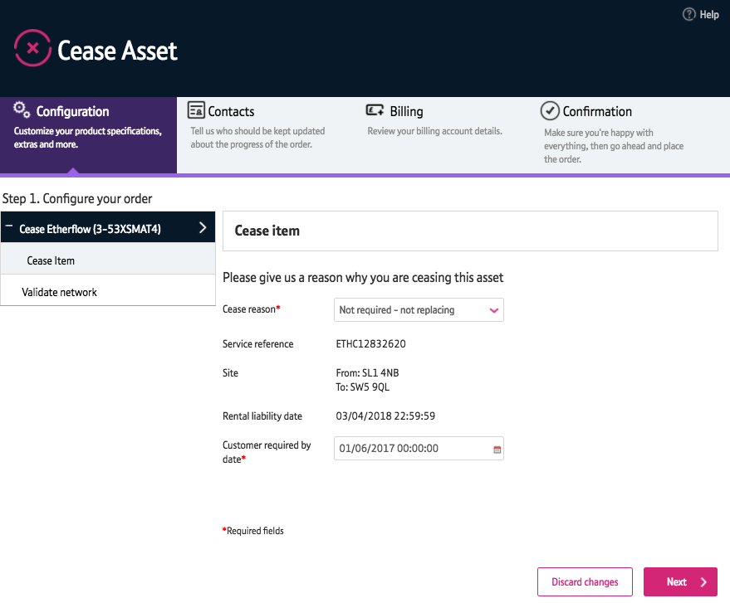
Introduction
What is the new Ethernet ‘Cease asset’ journey?
Cease asset is the journey used when ceasing an existing Ethernet service from BT Wholesale.
We’ve replaced the Eco Plus Cease asset journey with a new improved Cease asset journey via Business Zone.
The new journey has improved navigation and layout, is compatible with modern browsers, and is easier to use than the old Eco Plus journey.

Slide 5
Which products is Cease asset available for?
What is the new Ethernet ‘Cease asset’ journey?
The new Cease asset journey is now available from Business Zone for the following products:
Etherway
Etherway Copper
Etherflow Connected
Exchange Connect

Slide 6
The process
Search for your asset
Check to see if your asset can be ceased
Tell us why and when you’re ceasing the asset
Validate your network
Check your contacts and billing information
Submit the order.
NOTE: The ‘Discard changes’ button allows you to reset any changes you’ve made prior to submitting the Cease asset order.

Slide 7
Before you start
What do I need to access the new journey?
You need correct access and privileges, including access to Business Zone. If you don’t have this, please contact your company administrator or download our user guide
The journey is currently only available for assets based on combinations of Etherway, Etherway Copper and Etherflow Connect
You must be using a Windows machine and using the latest version of Internet Explorer, Chrome or Firefox
Mobile devices, Mac and the Safari browser are not currently supported

Slide 8
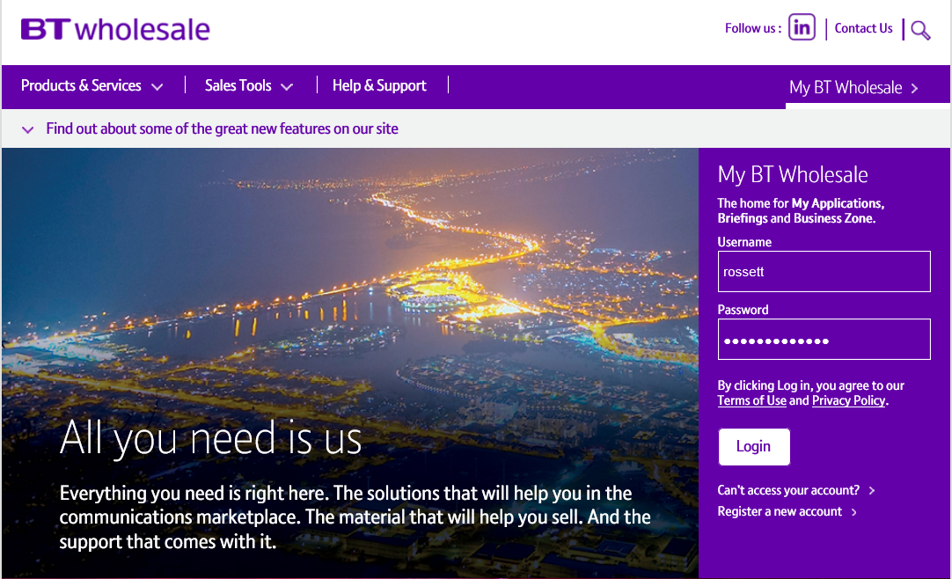
1. Logging in
Go to www.btwholesale.com
Enter your Username and Password
Click ‘Login’

Slide 9
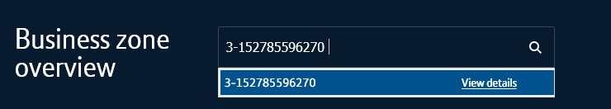
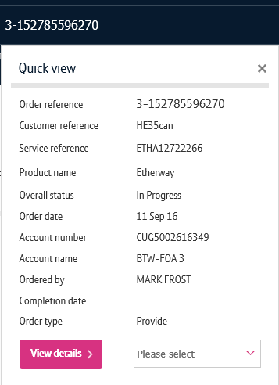
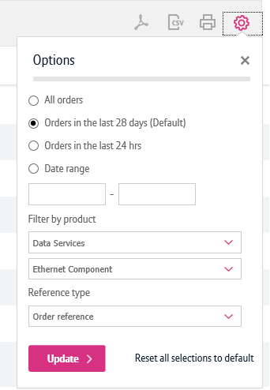
2. Searching for an asset
There’s a lot of different ways you can search for an asset in My BT Wholesale. The easiest way is by entering your asset reference in the search bar.
Click on the reference number to see the asset ‘Quick View’
You can also find the asset by using the filters on both the assets section of the Overview page and on the ‘My assets’ page
1
2

Slide 10
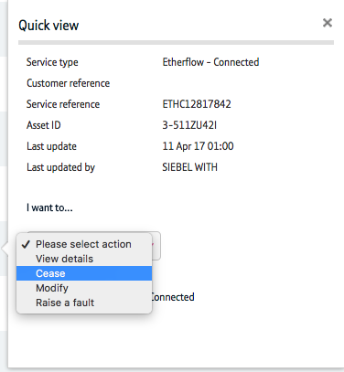
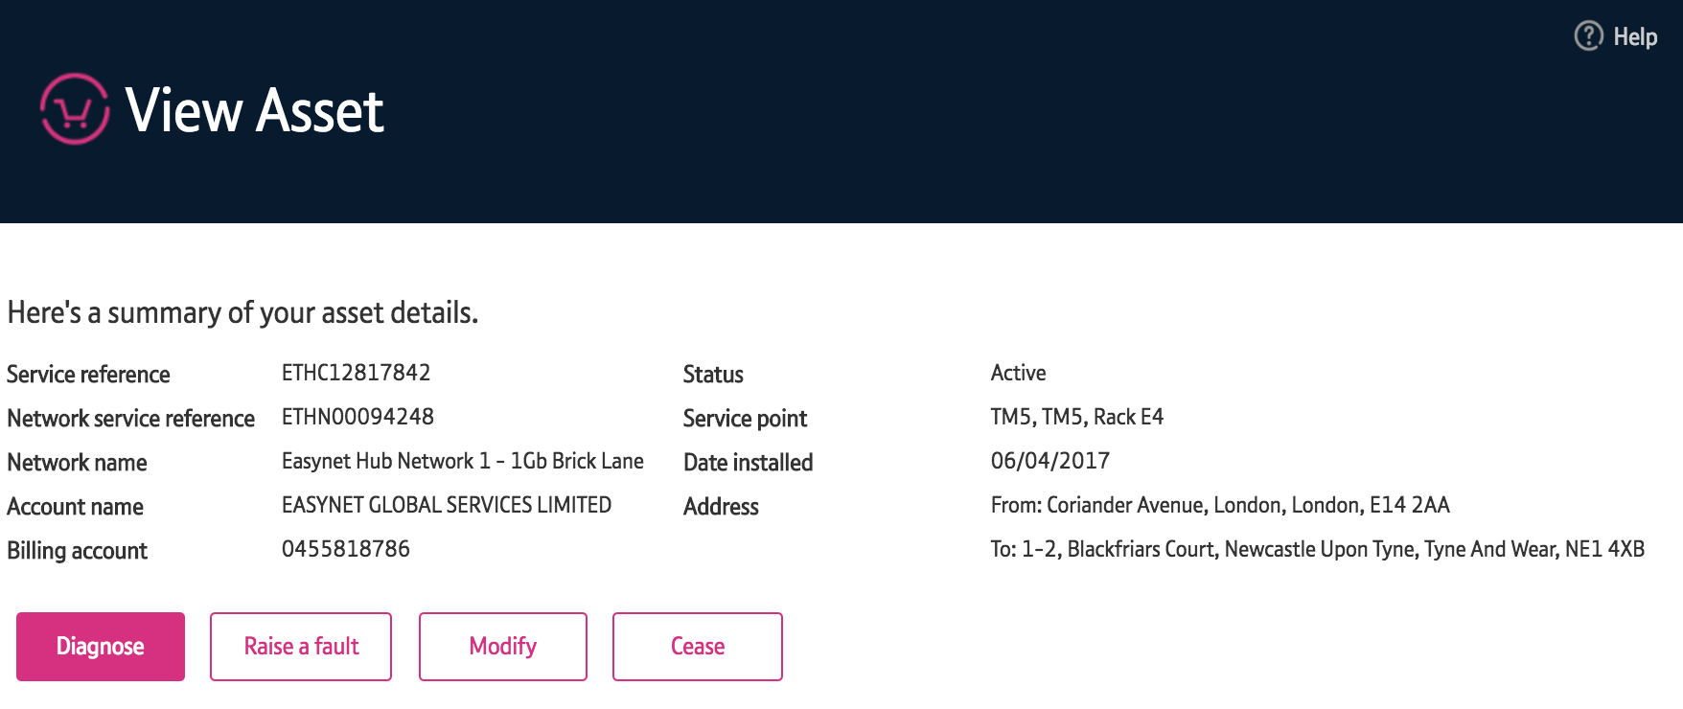
3. Start the Cease asset journey
Once you’ve searched for your asset, there’s two ways you can start a Cease asset order journey.
On the Quick View, you can select ‘Cease’ from the dropdown
Click the ‘Cease’ button from the ‘View asset’ screen
1
2

Slide 11
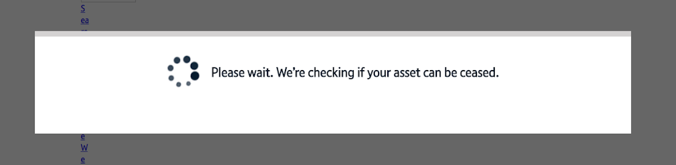
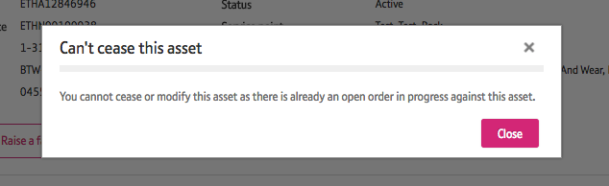
4. Checking if you can cease the asset
A check will then be carried out to see if that particular asset can be stopped on this journey.
If it cannot, a pop-up window will let you know why, and you’ll be taken back to the ‘View asset’ screen.

Slide 12
5. Configuring your order
Select a reason for stopping the service from the drop down menu.
Select the date when you want the service to stop.
Both these fields are required to continue.
Click ‘Next’ to proceed.
Note: Once you’ve selected from these options and pressed ‘Next’ you will not be able to go back and make changes to these options. To make changes, you will have to start a new Cease asset order from the ‘View asset’ screen.
1
2

Slide 13
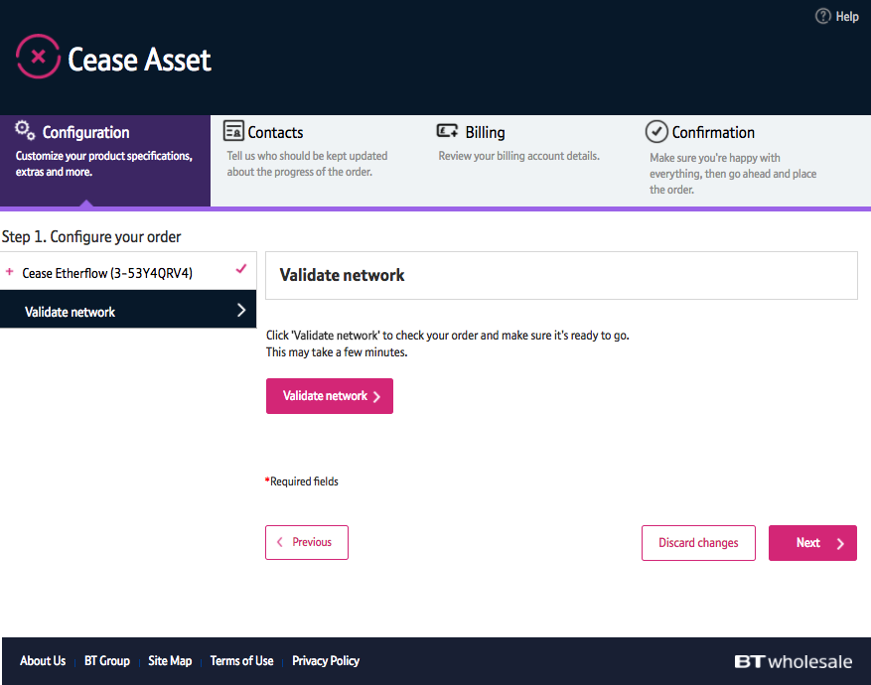
6. Validate your network
We’ll need to check your network is ready to receive a Cease asset order.
Press the ‘Validate network’ button and wait for the process to complete
Press ‘Next’ to continue when your network is validated.
1
2

Slide 14
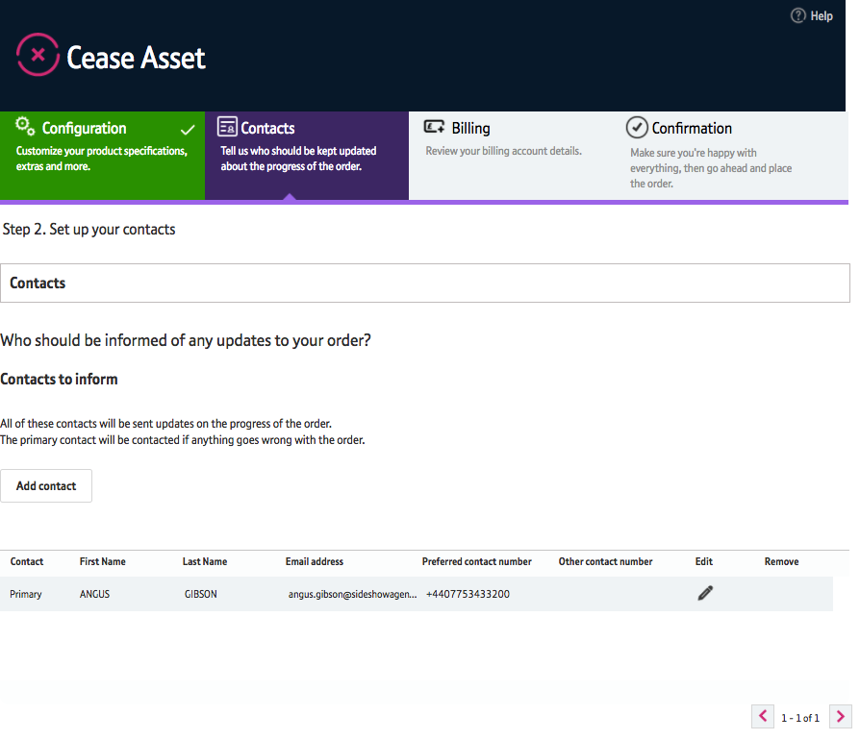
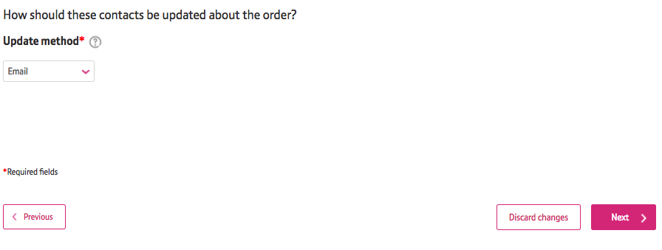
7. Check contacts
On this screen you can see and change who will be kept up to date about the progress of the Cease asset order.
You can add a new contact here
You can edit contact details here
You can select how the contact(s) should be kept updated here
Press ‘Next’ to continue.
Note: Once you’ve made your selection and pressed ‘Next’ you will not be able to go back and make changes to these options. To make changes, you will have to start a new Cease asset order from the ‘View asset’ screen.
1
2
3

Slide 15
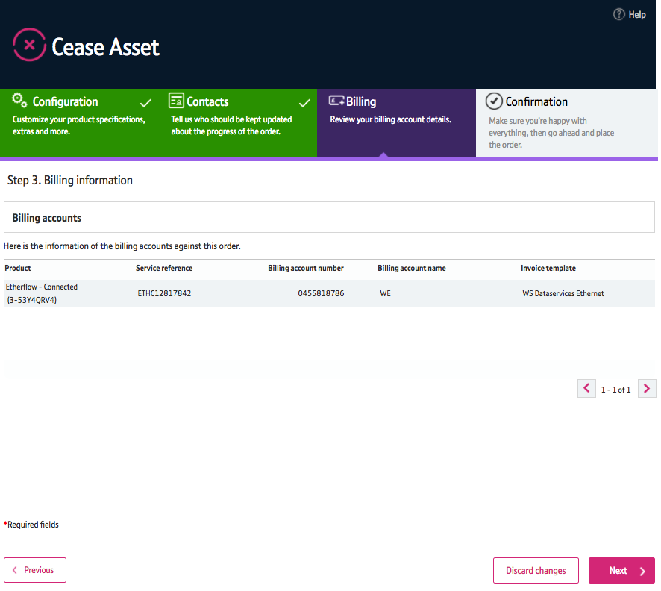
8. Billing
This screen shows the account against which this order is billed, for your information.
Press ‘Next’ to continue.

Slide 16
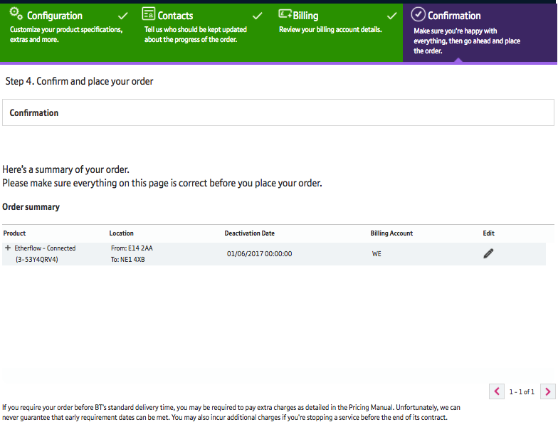
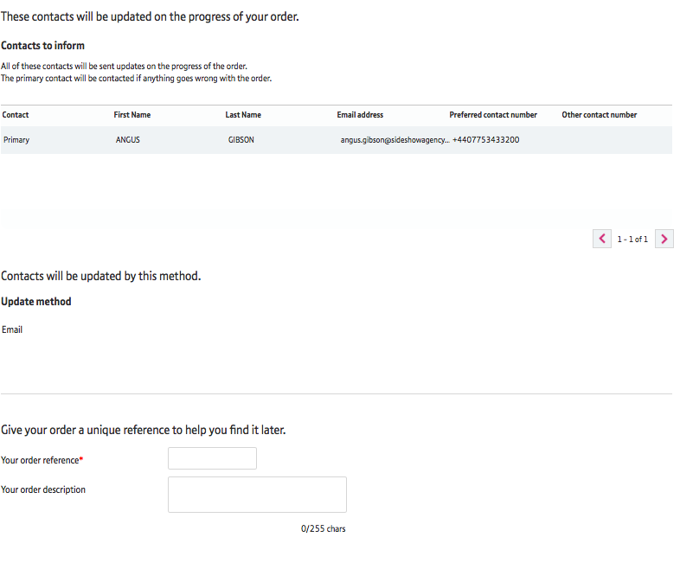
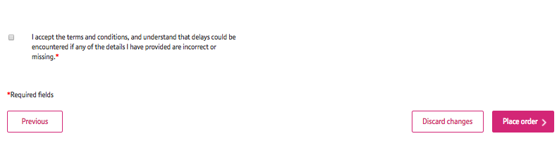
9. Confirmation
This screen shows the details of the Cease asset order. Check everything is correct before you submit your order.
You must enter a reference for your order here.
You must confirm that you agree with the Terms & Conditions by ticking this box.
Press ‘Place order’ to continue.
1
2

Slide 17
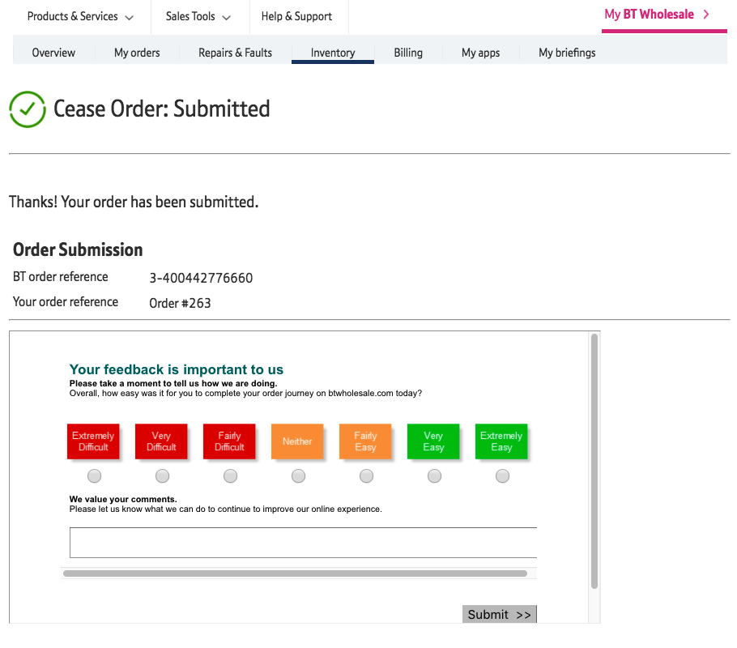
10. Order submitted
Success! Your order has been received.
We would be very grateful if you filled in our feedback form on this page. This will help us improve the BT Wholesale online experience.
Click on ‘My BT Wholesale’ at the top of the screen to return to your account.

Slide 18
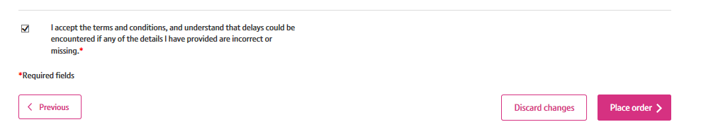
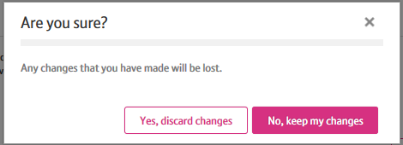
Important: Discarding changes
If you want to delete any changes you’ve made prior to submitting your Cease asset, you can do so by clicking the ‘Discard Changes’ button on most screens
You’ll then need to confirm you wish to discard your changes you’ve made by clicking ‘Yes, discard changes’
Any changes you’ve made will be deleted and you’ll be returned to the ‘View asset’ screen.
Note: All changes you make to your asset must be compatible with the connecting Etherway, Etherflow and network. To learn more about this, please visit the Wholesale Ethernet Product Handbook. (You’ll need to be logged in to access this).
1
2

