Slide 1

Amending an Ethernet order
BT Wholesale Online
V2
LEGAL NOTICE: The information contained in this briefing is confidential information as per your terms and conditions with BT. Please do not forward, republish or permit unauthorised access. The content is accurate at the time of writing and is subject to change.

Slide 2
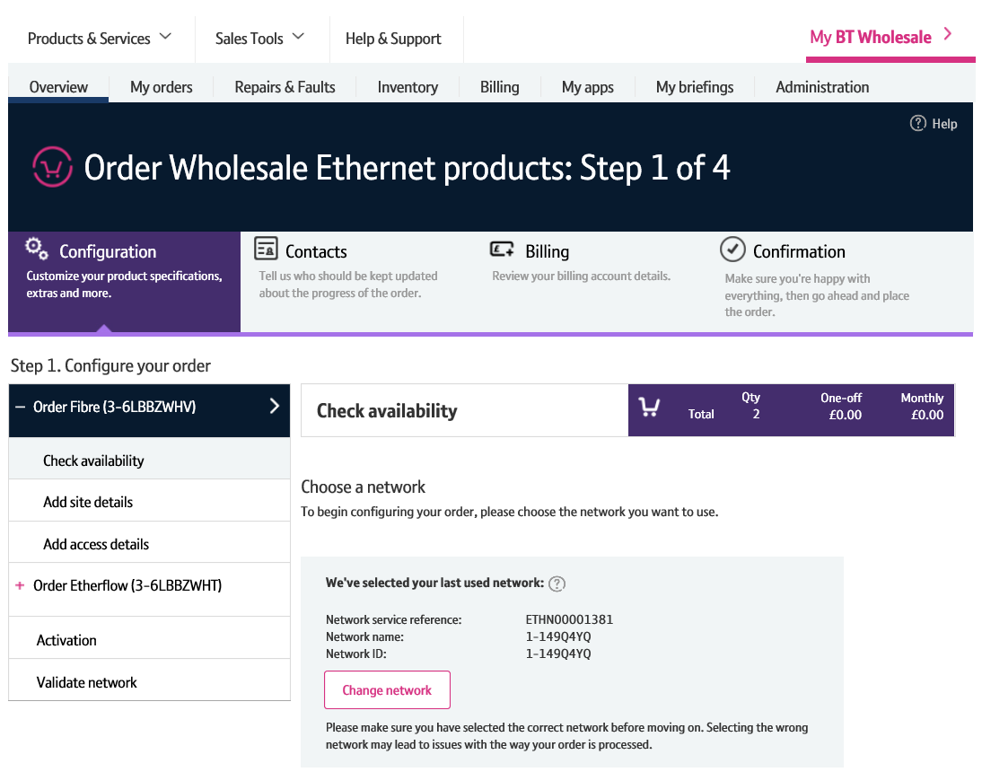
Contents
What’s in this User Guide?
p4 - Pre-requisites
p5 – Introduction
p6 – Layout
p7 – What can I amend?
p8 – How do I amend an order?
p9 – Searching for an order
p11 – Initiate the amend order
p12 – Making your amendments
p17 – Discard changes

Slide 3
Version Control
Date | Change | Version
16/01/17 | User Guide Published. | 1
30/04/18 | Re-branded | 2

Slide 4
Pre-Requisites
What do you need to enter an Ethernet order via the new journey?
You need correct access and privileges, including Business zone. If you don’t have this, please contact your company administrator to action.
Please visit our Transformed Ethernet Ordering page to learn about what order journeys are available.
You must be using a Windows machine and using the latest version of Internet Explorer, Chrome or Firefox
Mobile devices, Mac and Safari are not supported

Slide 5
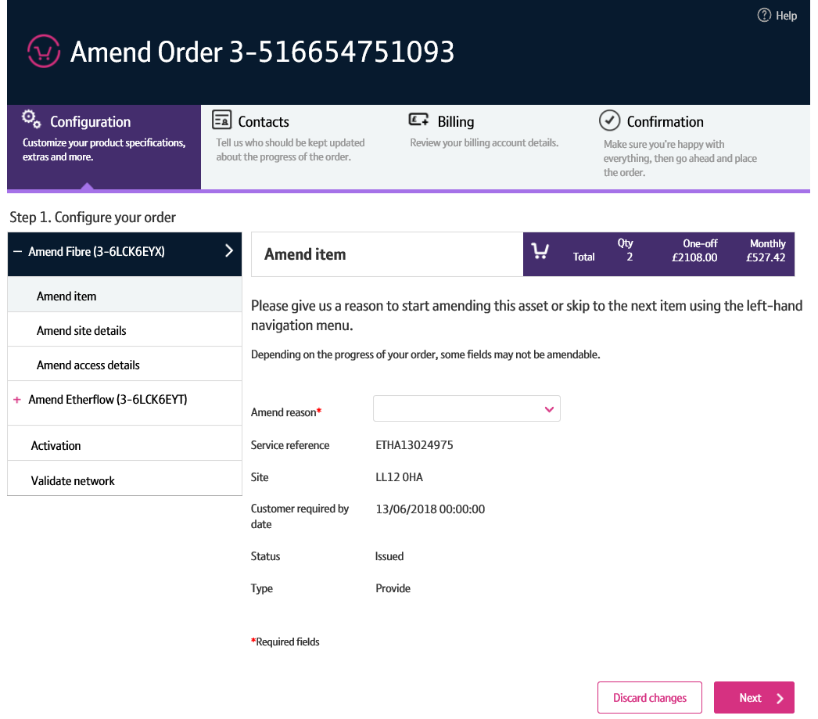
Introduction
We’ve replaced the current Eco Plus amend order journey with a new improved view order journey for Ethernet.
Accessed via Business Zone, the new journey will allow you to make it easier to:
Amend details of an order that’s in progress.
The new journey has improved navigation and layout, is compatible with modern browsers and easier to use than Eco Plus.

Slide 6
Layout
1. Navigation menu
An order can often consist of multiple Ethernet components (Etherways and Etherflows). You can use the left hand menu to select the component you wish to amend.
2. Order configuration
To make an amendment to your order, simply make the changes here, validate and confirm the amendment. Navigation is the same as when you placed the order.
Attributes that you can’t amend will be greyed out or read only.
3. Discard changes
The ‘Discard changes’ button allows you to reset any changes you’ve made prior to submitting the amend order.
1
2
3

Slide 7
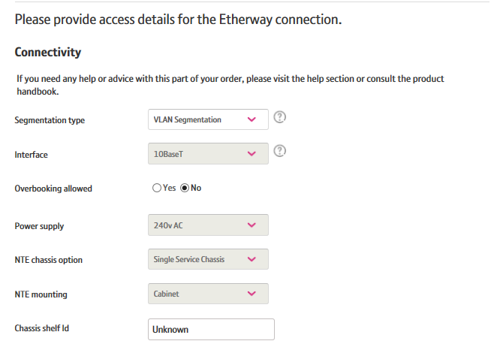
What can I amend?
Attributes you can amend
Although not an exhaustive list, the following attributes can be amended on an Etherway order depending on it’s progress:
Bandwidth
Resilience
Access Pricing Period
Contact details
Notes
Site and Access details
Attributes you can’t amend
For Etherway Fibre, as your order progresses some attributes will become un-amendable. These include:
Service point details (Room, Floor and Location)
Site Contact details
Hazard and special arrangement notes
Bandwidth
Resilience
Access pricing period
Connectivity details such as Interface Type, Power Supply NTE Chassis and mounting Options
Pre-authorised excess construction charges

Slide 8
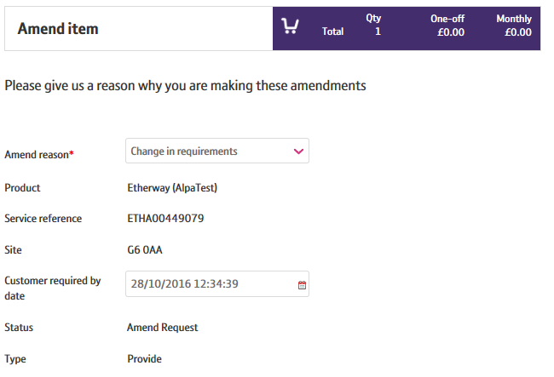
How do I amend an order?
There’s a number of steps that need to be performed in order for you to change details on your order:
Search for your order
First you’ll need to search for your order on My BT Wholesale. From here, you can instigate the amendment.
Check to see if your order can be amended
We’ll then need to check that your order can be amended. Depending on how far your order has progressed, some attributes may become un-amendable. If your order can’t be amended, we’ll tell you.
Tell us why you’re amending the order
If your order is amendable, you’ll be taken to the order entry screens. Here, you’ll need to first tell us why you’re amending the order.
Make your changes
You can then make the changes you require within the order journey. Any attributes that can’t be amended will be inaccessible and greyed out or read only.
Submit the amend order
Once you’ve made your changes, you’ll need to submit them in the same way you placed your original order.

Slide 9
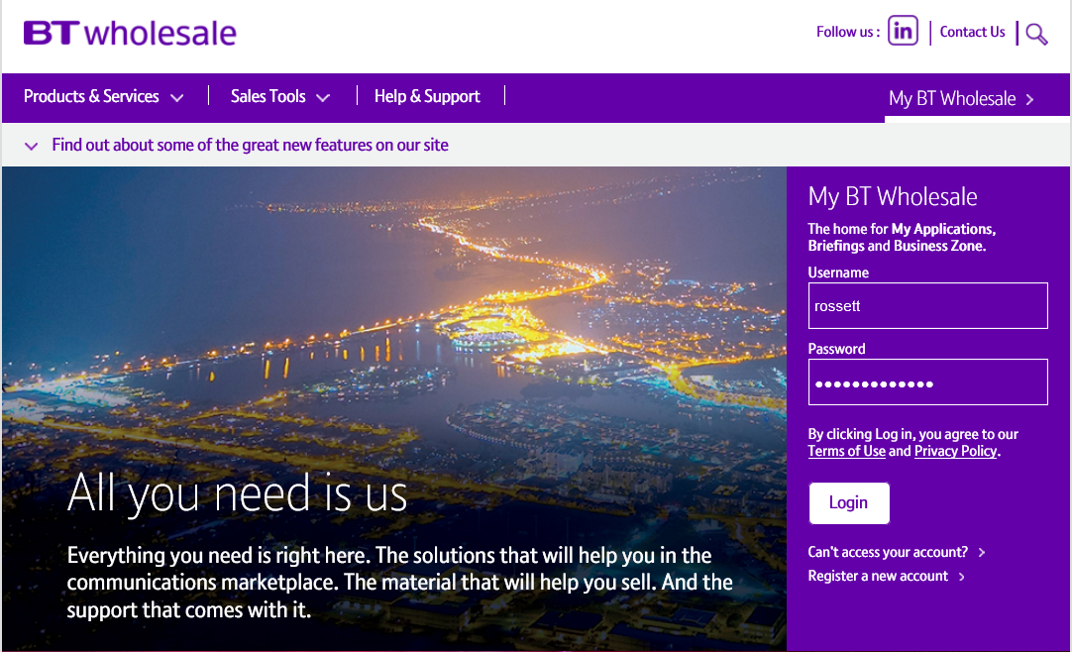
Searching for an order
Step 1: Logging In
Go to www.btwholesale.com
Enter your Username and Password
Click ‘Login’

Slide 10
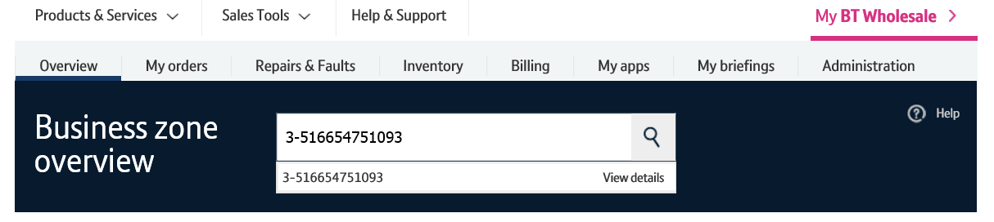
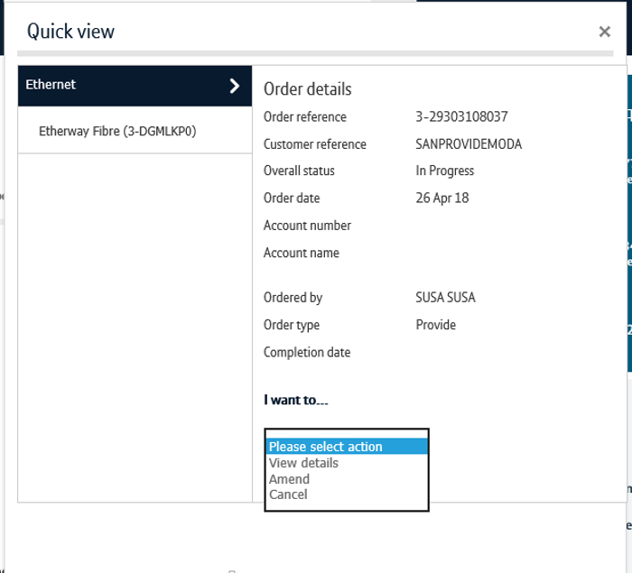
Searching for an order
Step 2: Searching
There’s a lot of different ways you can search for an order in Business Zone. The easiest way is by entering your order reference in the search bar.
Clicking ‘View Details’ will take to directly into the View Order journey. There’s an ‘Amend’ option here.
Alternatively, click on the reference number to see the order quick view
From the quickview, click ‘Amend’ in the actions dropdown.
You can also find the order by using the filters on the orders section of the Overview page and on My orders page. Please see the Business Zone guide for more details.
2
1
3

Slide 11
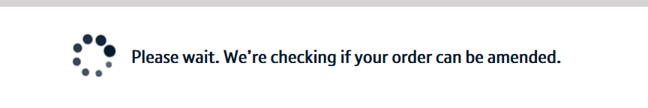
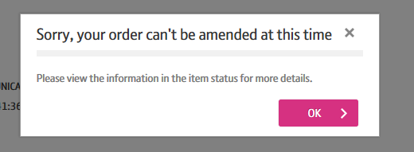
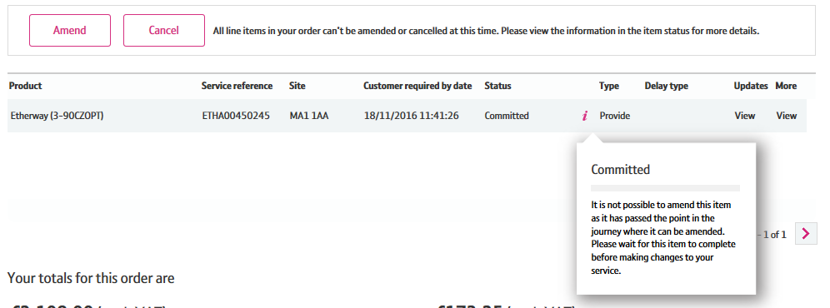
Initiate the amend order
Once the amend order has been initiated, a check will be carried out to see if the order can be amended.
If the order is past the point of when it can be amended (Point of no amend or PONA for short), you’ll be taken to the ‘View Order’ screen.
Here, you’ll be told will be told the order can’t be amended.
You can then click the ‘i’ icon next to the ordered component to learn why it can’t be amended.
1

Slide 12
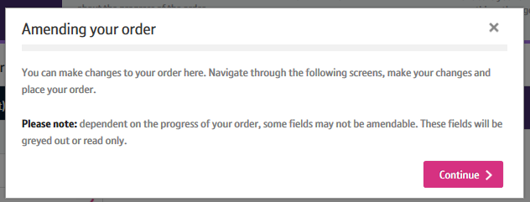
Making your amendments
Once the amendment has been initiated, you’ll be taken to the order entry screen.
Here, you’ll be presented with instructions on how to submit your amendments.
1. Click ‘Continue’ to proceed.
1

Slide 13
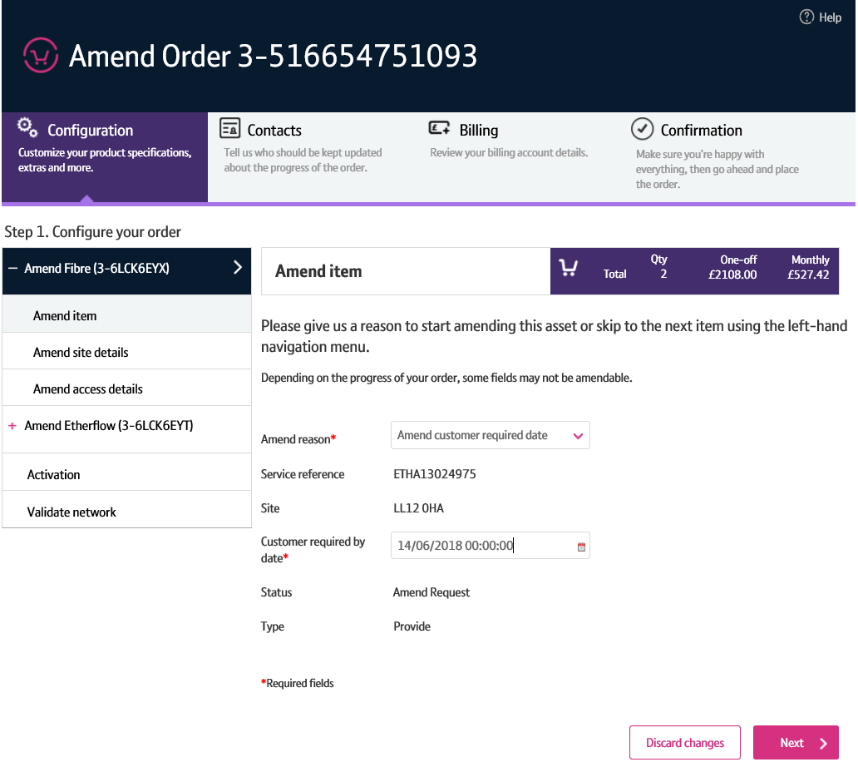
Making your amendments
You’ll now see the ‘Amend Item’ screen for the first component in your order.
From here, you’ll see the components that make up your order listed in the left hand menu. This is clickable, allowing you to select the component you wish to amend within your order.
To amend the selected component, choose an amend reason from the ‘Amend Reason’ field.
If you want to change the ‘Customer Required by Date’, you can do this here. But you must select the applicable option to activate this field.
Click Next to begin making your amendments.
Note: if you haven’t selected an amend reason, clicking ‘Next’ will take you to the next component within your order.
1
2
3
4

Slide 14
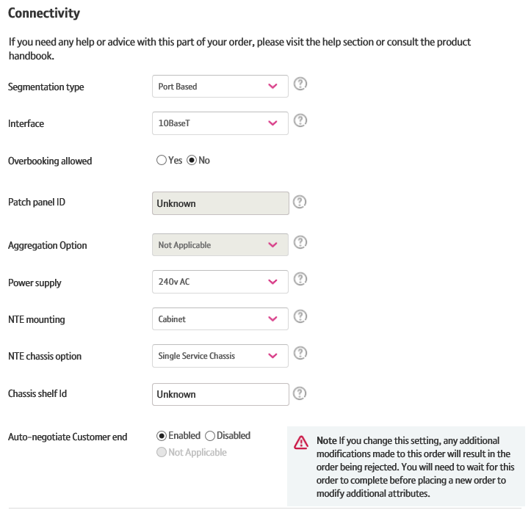
Making your amendments
You’ll now be taken through the same journey that you followed when placing your order.
Attributes that can’t be amended will be greyed out or read only.
You’ll need to proceed through the order, making any amendments as you go along.

Slide 15
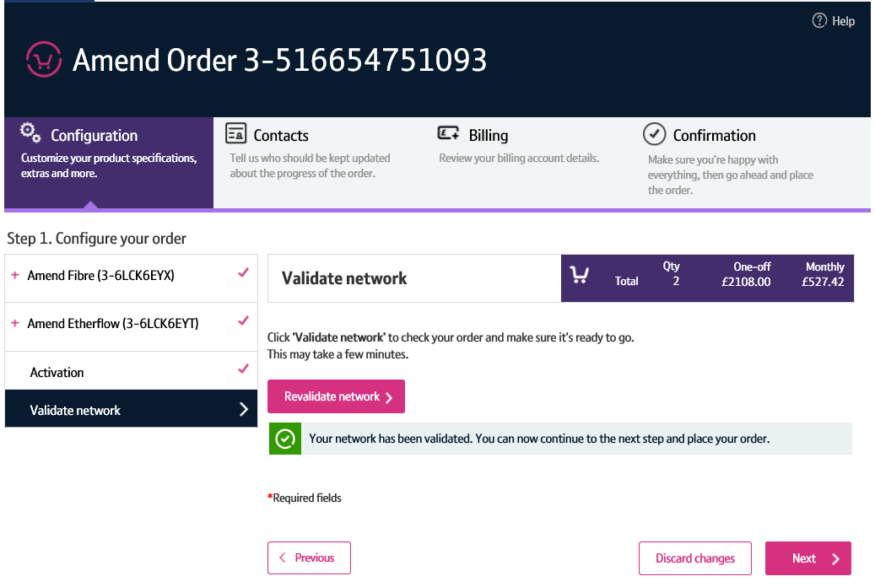
Making your amendments
Once you’ve made your changes, you’ll need to validate them.
This will check that the changes you have made are compatible with the service you’ve ordered.
Note: Some changes, such as segmentation, must be compatible on both the Etherway and Etherflow.

Slide 16
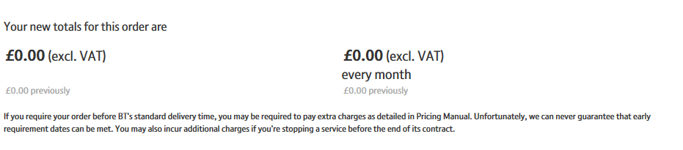
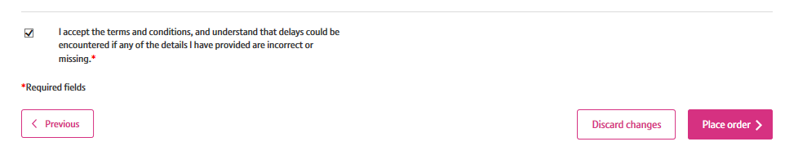
Making your amendments
Once your changes have been validated, you’ll need to proceed to the ‘Confirmation’ step.
Here you can see any changes to the cost of your order as a result of your amendments.
Once you’re happy with the changes you’ve made, click ‘Place Order’.
Your amendments will now be submitted and reflected when viewing your order.
1
2

Slide 17
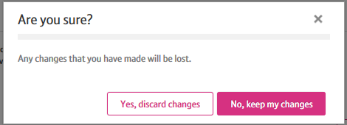
Discarding changes
If you want to reset the amendments you’ve made prior to placing your amend order, you can do so by clicking the ‘Discard Changes’ button.
You’ll then need to confirm you wish to cancel the changes you’ve made by clicking ‘Yes, discard changes’.
Any changes you’ve made will be reset and you’ll be returned to the ‘View Order’ screen.
Note: You can’t discard changes on either the Add Access screen for Etherway or the Add Connection Details screen for Etherflow.
1
2

