Slide 1

Getting access to the Ethernet Diagnostics and Fault journeys on Business Zone
BT Wholesale Online
V2
LEGAL NOTICE: The information contained in this briefing is confidential information as per your terms and conditions with BT. Please do not forward, republish or permit unauthorised access. The content is accurate at the time of writing and is subject to change.

Slide 2
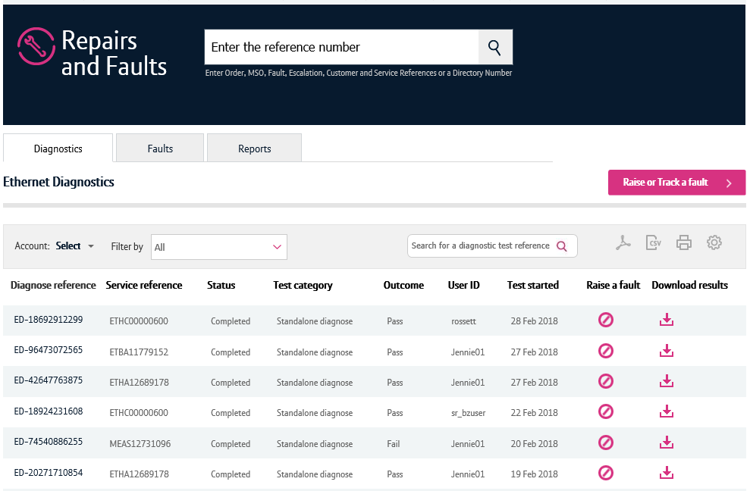
Contents
What’s in this Guide?
p3 - Version Control
p4 – How to get access to the diagnostic & fault journeys on Business Zone
P5 – How to provide access to the Ethernet diagnostics and fault tools
P6 - Searching for a user
P7 - Changing access

Slide 3
Version Control
Date | Change | Version
13/06/18 | Added details on how to provide access on Eco Plus | 2
15/03/18 | User Guide Published. | 1

Slide 4
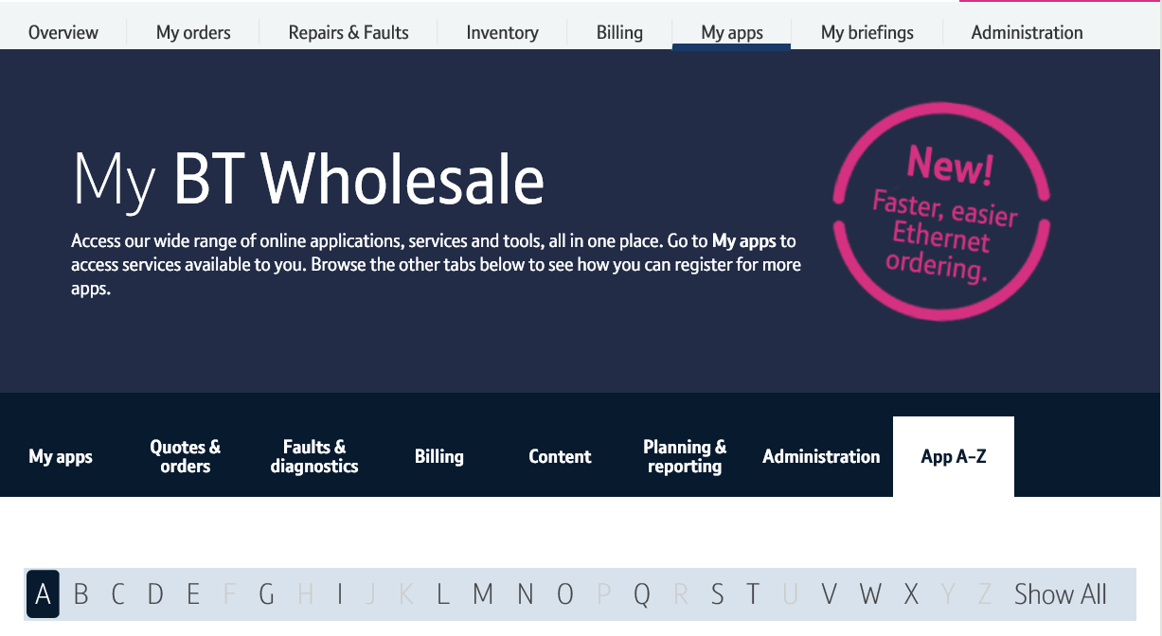
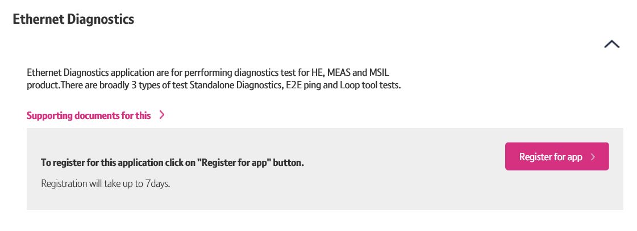
How to get access to the diagnostic & raise fault journeys on Business Zone
How do you get access to the new journey?
To access the new journey, you first need to obtain access to Business Zone. Your company administrator can help you with this. If you don’t know who your company administrator is, or if you’re a company administrator providing access to one of your colleagues, please follow our Getting access to Business Zone user guide.
Once you have access to Business Zone, you’ll need to request access to the new Ethernet diagnostics journey from the My Apps section.
In My Apps, click App A-Z
Select the letter E for Ethernet
Navigate to the Ethernet Diagnostics and/or Ethernet Loop Diagnostics.
Click register for app
A notification will be sent to your administrator for access.
1
2
3
4
5

Slide 5
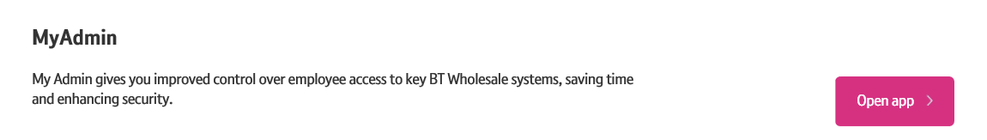
How to provide access to the Ethernet Diagnostics, Loop and Fault journey
1
Step 1: Launch My Admin
If you’re a company administrator, you’ll be able to provide your agents access to the new Ethernet Diagnostics, Loop tool and fault journey using My Admin and Eco Plus.
Navigate to My Apps
Select the Administration tab
Expand the MyAdmin accordion
Click Open App
2
3

Slide 6
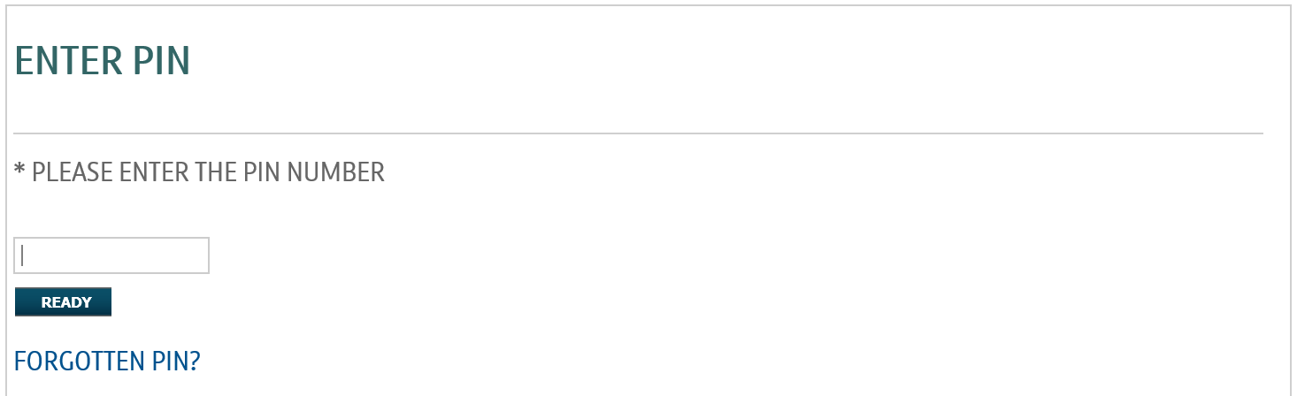
How to provide access to the Ethernet Diagnostics, Loop and Fault journey
Step 1: Launch My Admin
When prompted, enter your PIN and click ready
1

Slide 7
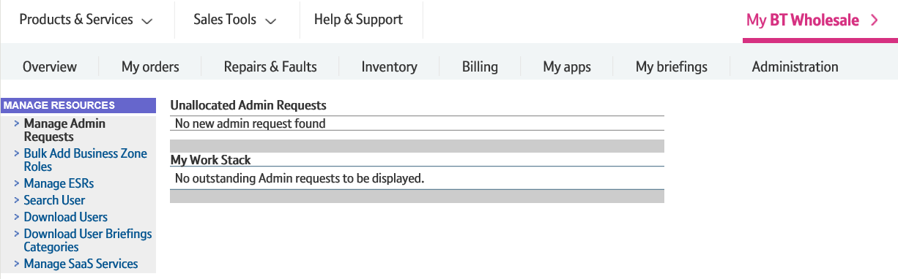
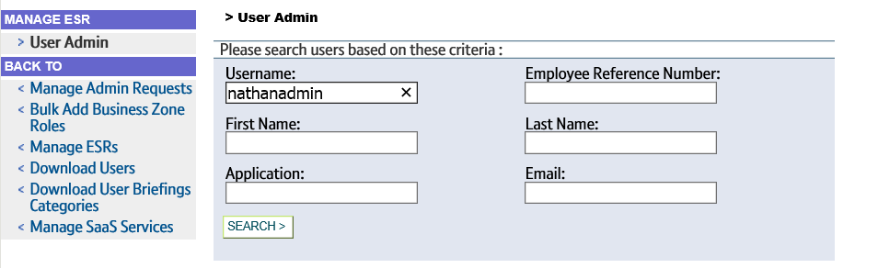
How to provide access to the Ethernet Diagnostics, Loop and Fault journey
Step 2: Searching for a user
Once logged into My Admin, you’ll need to search for the user who needs access.
Click on ‘Search User’ from the left hand navigation
Enter the user’s details. It’s best to just enter the username.
Click search
1
2
3

Slide 8
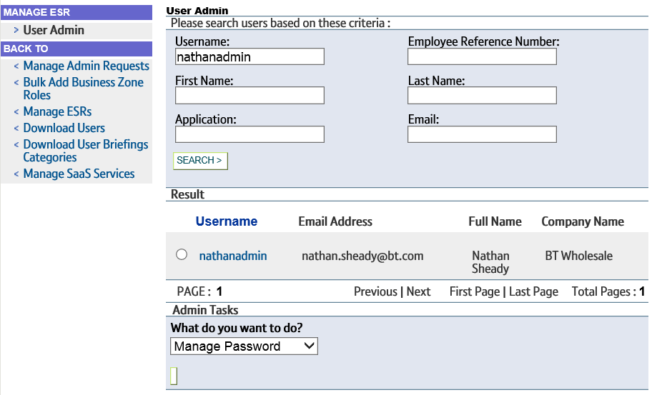
How to provide access to the Ethernet Diagnostics, Loop and Fault journey
Step 2: Searching for a user
The agent’s details will now be displayed.
Click the username hyperlink.
1

Slide 9
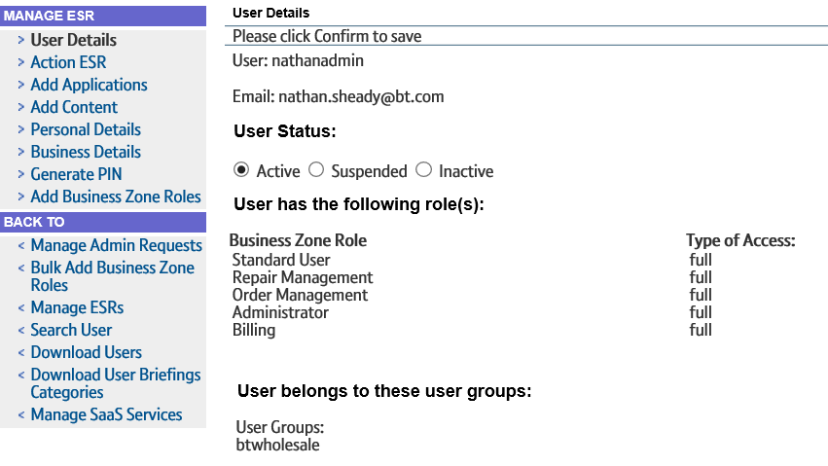
How to provide access to the Ethernet Diagnostics, Loop and Fault journey
Step 3: Adding the access
A summary of the access the agent has will now be displayed
Click the ‘Add Business Zone Roles’ hyperlink from the left-hand menu.
1

Slide 10
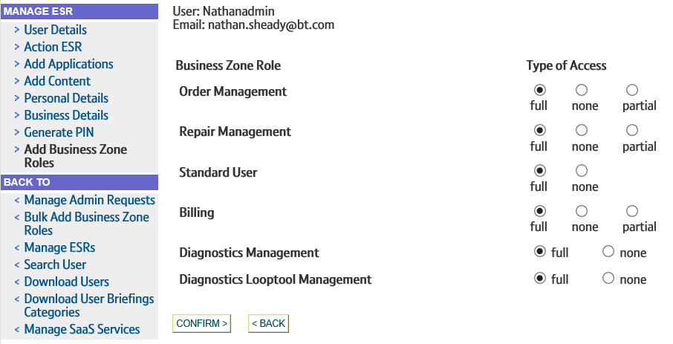
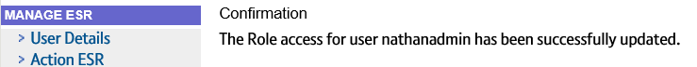
How to provide access to the Ethernet Diagnostics, Loop and Fault journey
Step 3: Adding the access
You can provide the new access from this screen.
1. Select the following:
    Diagnostic Management : full
    Diagnostic Looptool Management : full
2. Click ‘CONFIRM’
3. You’ll be presented with a confirmation page.
Accessing the new Diagnostics will now be granted, however, you’ll also need to provide this access via Eco Plus too in order for this to work on Business Zone
1
2
3

Slide 11
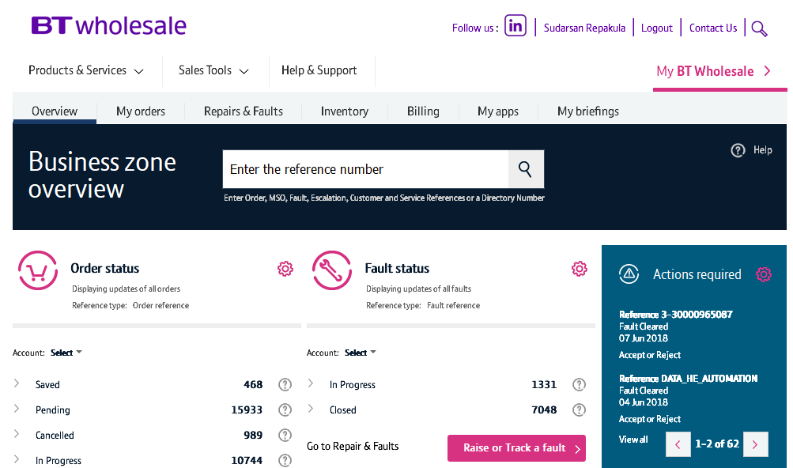
How to provide access to the Ethernet Diagnostics, Loop and Fault journey
Step 4: Adding the access – Eco Plus
1. Click ‘My Apps’ from the Business Zone menu.
1

Slide 12
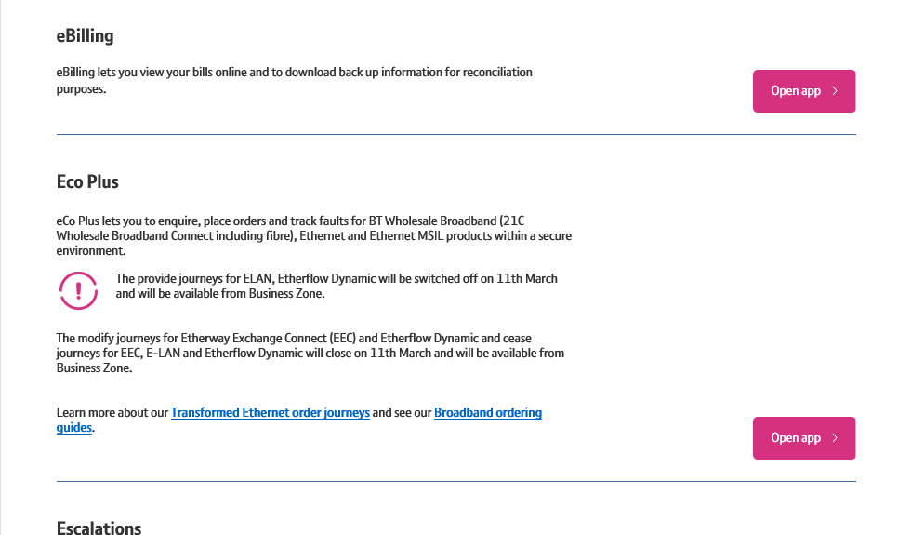
How to provide access to the Ethernet Diagnostics, Loop and Fault journey
Step 4: Adding the access – Eco Plus
1. Scroll down to Eco Plus and click ‘Open App’
1

Slide 13
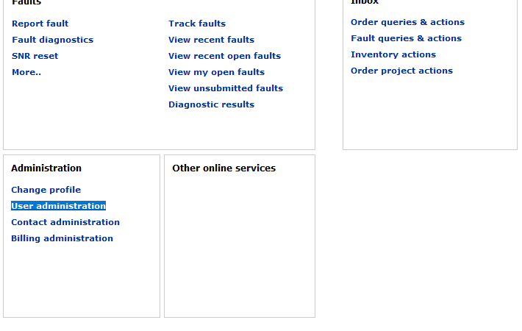
How to provide access to the Ethernet Diagnostics, Loop and Fault journey
Step 4: Adding the access – Eco Plus
1. Click ‘User Administration’
1

Slide 14
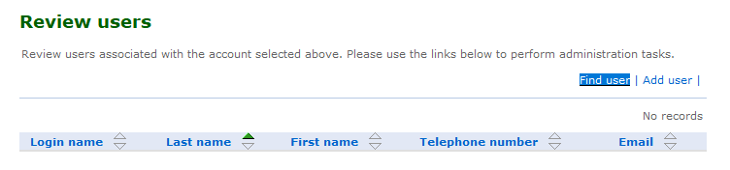
How to provide access to the Ethernet Diagnostics, Loop and Fault journey
Step 4: Adding the access – Eco Plus
1. Click ‘Find User’
1

Slide 15
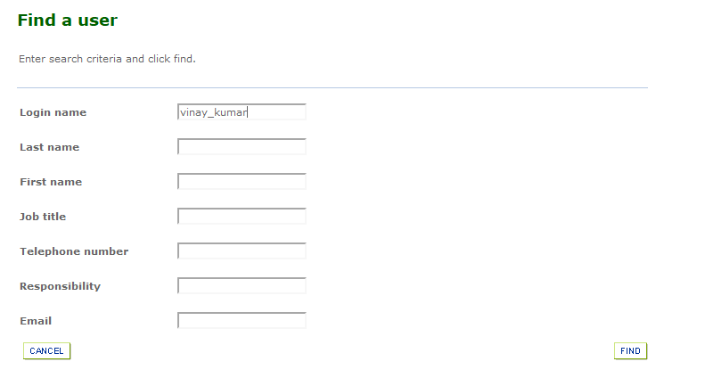
How to provide access to the Ethernet Diagnostics, Loop and Fault journey
Step 4: Adding the access – Eco Plus
Enter the users details
Click ‘Find’
1
2

Slide 16
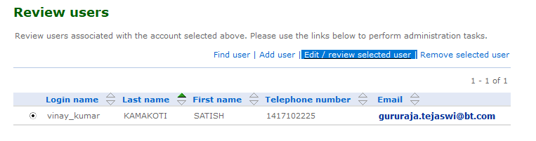
How to provide access to the Ethernet Diagnostics, Loop and Fault journey
Step 4: Adding the access – Eco Plus
Click ‘Edit/review selected user’
1

Slide 17
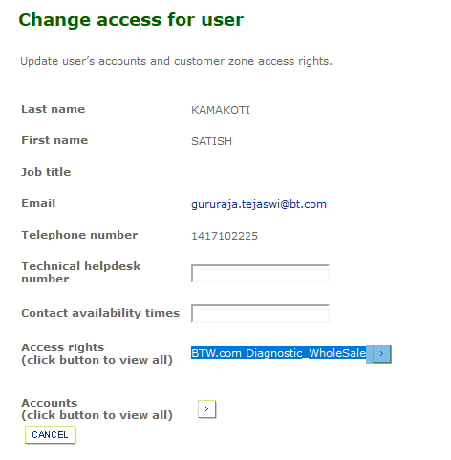
How to provide access to the Ethernet Diagnostics, Loop and Fault journey
Step 4: Adding the access – Eco Plus
Click the chevron next to ‘BTW.com Diagnostic_Wholesale’
1

Slide 18
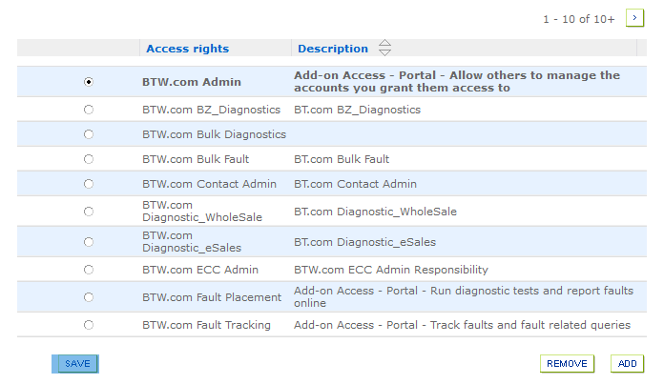
How to provide access to the Ethernet Diagnostics, Loop and Fault journey
Step 4: Adding the access – Eco Plus
Select ‘BTW.com BZ_Diagnostics
Click Save
1
2

Slide 19
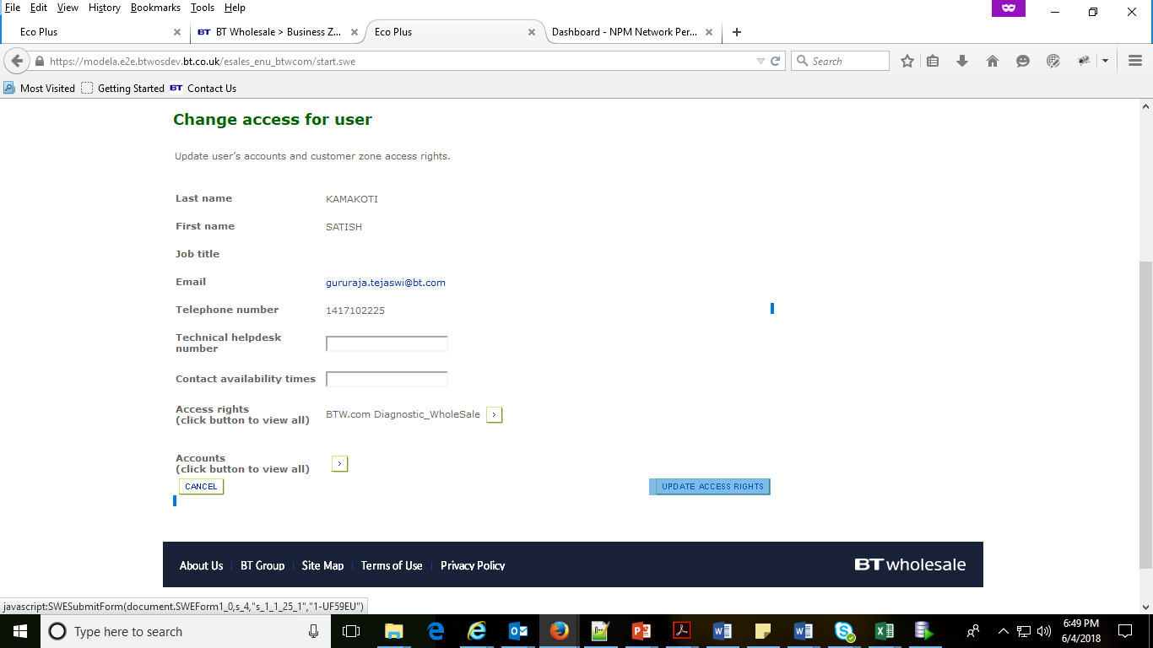
How to provide access to the Ethernet Diagnostics, Loop and Fault journey
Step 4: Adding the access – Eco Plus
Click ‘Update Access Rights’
1

Slide 20
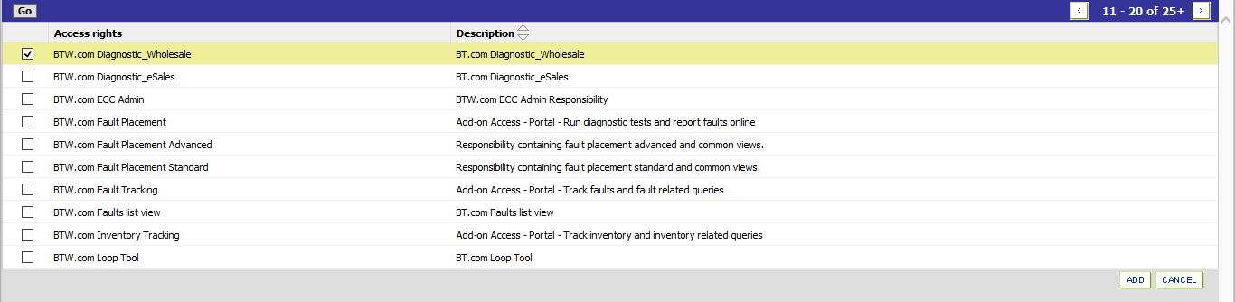
How to provide access to the Ethernet Diagnostics, Loop and Fault journey
Step 4: Adding the access – Eco Plus
Select the checkbox labelled ‘BT.com BZ_Diagnostics’
Click ‘Add’
1
2

Slide 21
How to provide access to the Ethernet Diagnostics, Loop and Fault journey
Step 4: Adding the access – Eco Plus
Click ‘Update Access Rights’
You’ll now have full access to both the diagnostic and fault journeys via Business Zone.
1

