Slide 1
Placing an order for E-LAN and Etherflow Dynamic
BT Wholesale Online
V2
LEGAL NOTICE: The information contained in this briefing is confidential information as per your terms and conditions with BT. Please do not forward, republish or permit unauthorised access. The content is accurate at the time of writing and is subject to change.

Slide 2
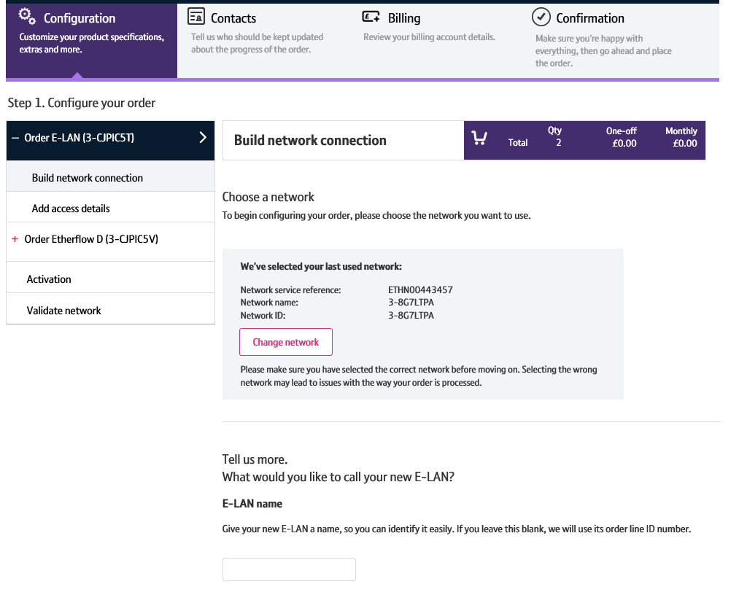
Contents
What’s in this User Guide?
p3 - Pre-requisites
p4 - How To Place an E-LAN and Etherflow Dynamic order

Slide 3
Version Control
Date | Change | Version
10/11/17 | User Guide Published. | 1
30/04/18 | Re-branded | 2

Slide 4
Pre-Requisites
What do you need to enter an Ethernet order via the new journey?
You need correct access and privileges, including Business zone. If you don’t have this, please contact your company administrator to action.
Please visit our Transformed Ethernet Ordering page to learn about what order journeys are available.
You must be using a Windows machine and using the latest version of Internet Explorer, Chrome or Firefox
Mobile devices, Mac and Safari are not supported

Slide 5
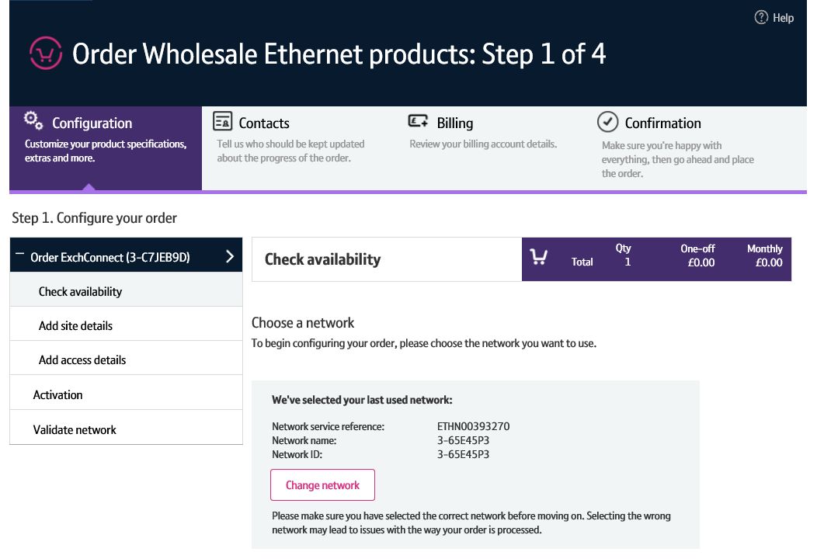
How to place an E-LAN and Etherflow Dynamic order
You can order E-LAN and Etherflow Dynamic via Business zone.
When ordering E-LAN, you’ll also be ordering an Etherflow Dynamic to connect an existing Etherway to the new E-LAN.
To order a standalone Etherflow Dynamic, you’ll be following the same journey, minus the provision of a new E-LAN.

Slide 6
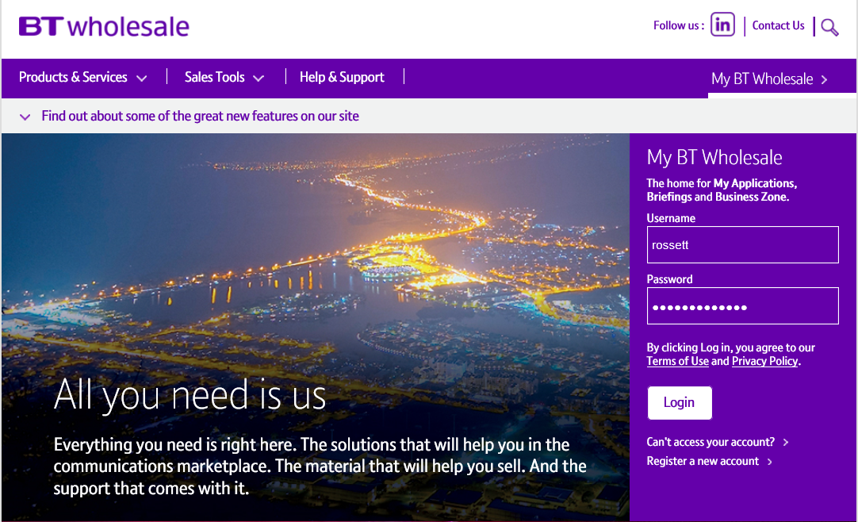
How to place an E-LAN and Etherflow Dynamic order
Step 1: Logging In
Go to www.btwholesale.com
Enter your Username and Password
Click ‘Login’

Slide 7
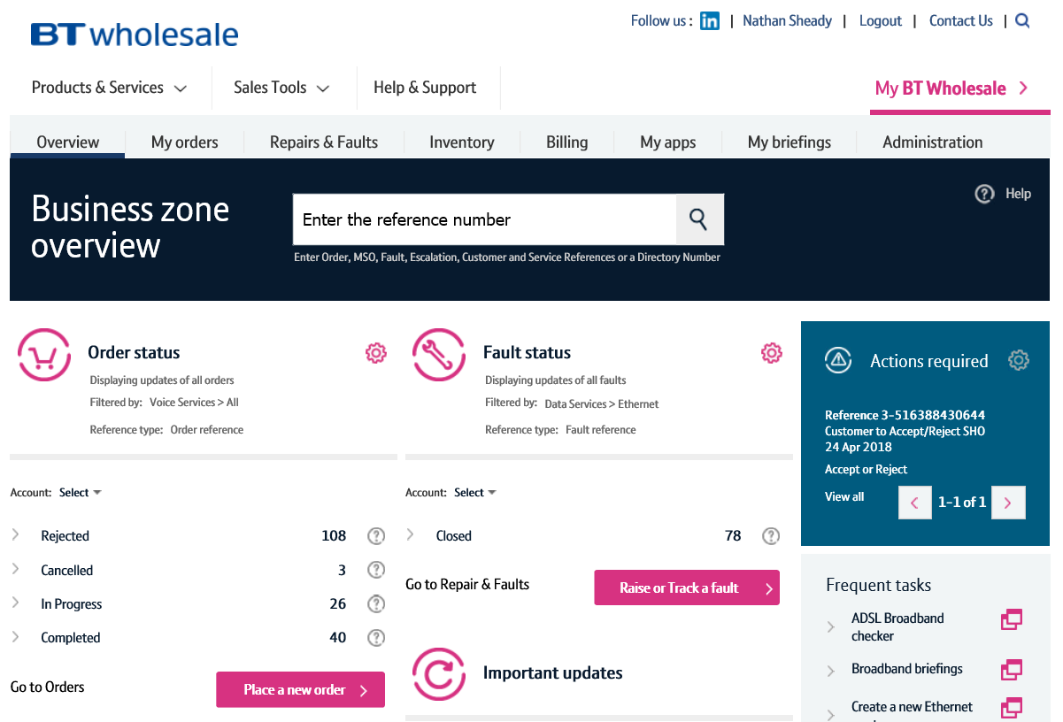
How to place an E-LAN and Etherflow Dynamic order
Step 2: Accessing the new journey
Once logged in, you’ll be taken to Business Zone.
If you aren’t taken to Business Zone, you’ll need to arrange access via your company administrator.
To access the new journey:
Click ‘Place a New Order’

Slide 8
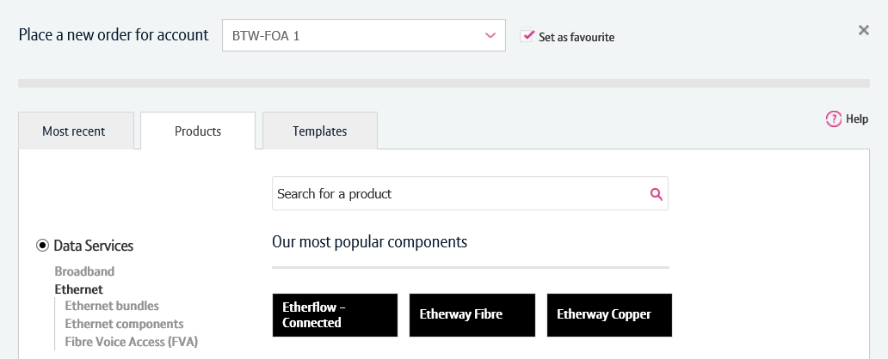
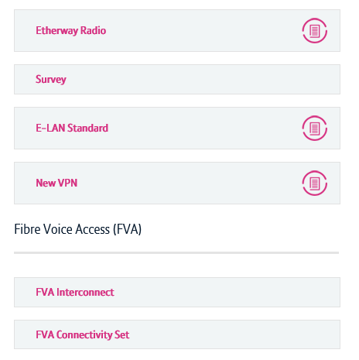
How to place an E-LAN and Etherflow Dynamic order
Step 2: Accessing the new journey
If you have multiple accounts associated with your user id, you’ll need to select the applicable account from the dropdown.
Select your account. If you use the same account time and time again, you can select ‘Set as favourite’ to default the selection.
Once an account has been selected, click the ‘Products’ tab.
Click ‘Data Services’.
Click ‘Ethernet’.
Click ‘Ethernet components’
Select ‘E-LAN Standard’ to order an E-LAN, or E-LAN Etherflow Dynamic to order a standalone Etherflow Dynamic.
1
2
3
4
5
6

Slide 9
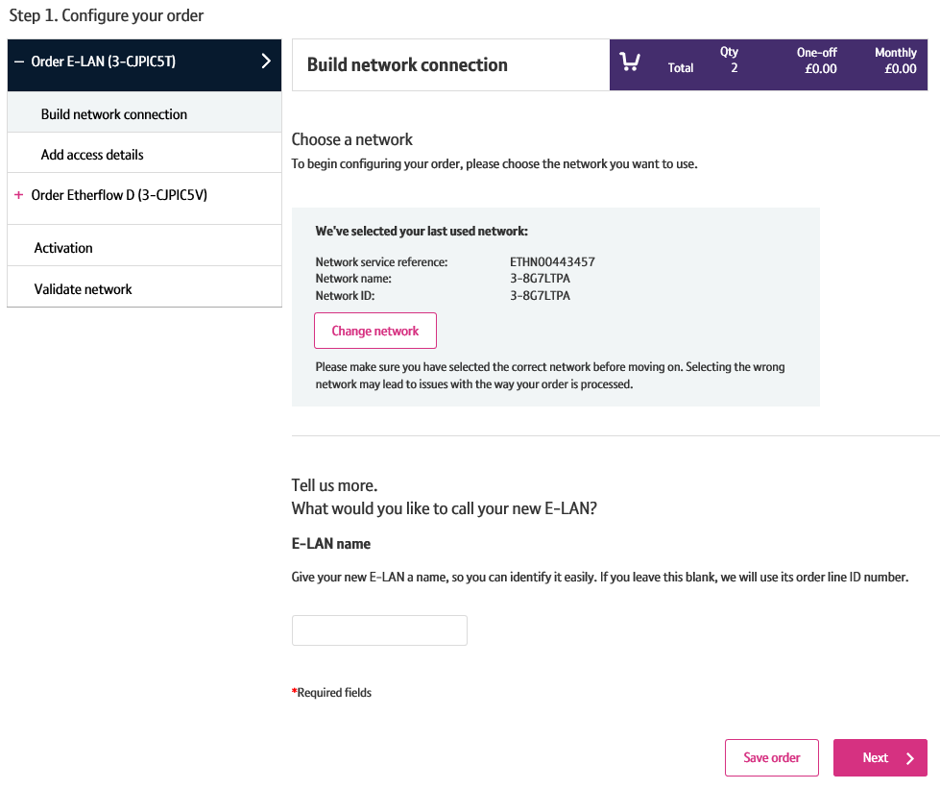
How to place an E-LAN and Etherflow Dynamic order
Step 2: Accessing the new journey
You’ll now be taken to the provide order journey.
Please Note: Logging in for the first time may take a few seconds longer.

Slide 10
How to place an E-LAN and Etherflow Dynamic order
Step 3: Choose a Network
You’ll begin by configuring your E-LAN.
First, you’ll need to tell us what network (ETHN) you wish the Etherway order to be placed against.
If you’ve previously placed an order with us, we’ll default this to the most recently used network to save you some time.
If you need to change is:
Click ‘Change network’
1

Slide 11
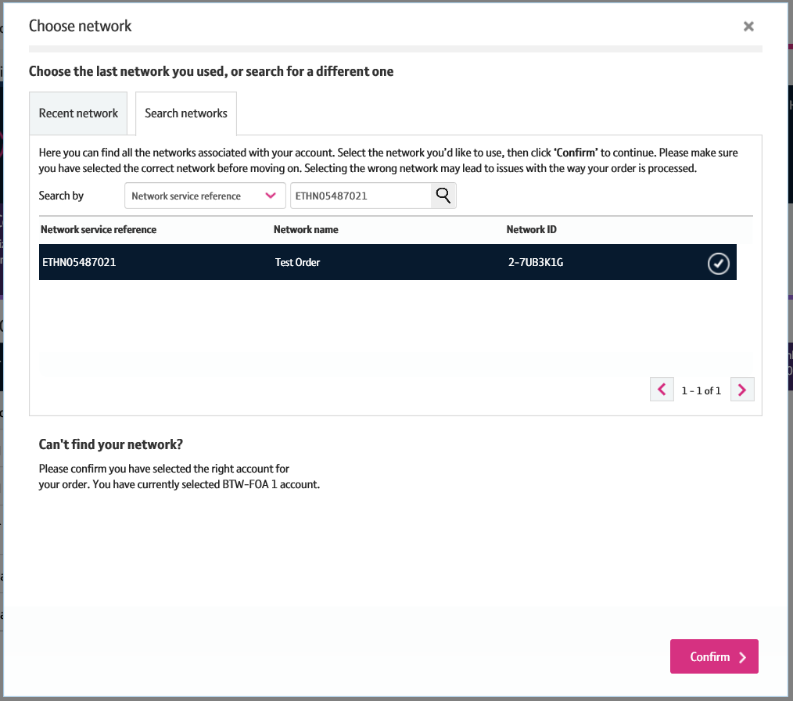
How to place an E-LAN and Etherflow Dynamic order
Step 3: Choose a Network
If you have recently entered a Wholesale Ethernet order via the new journey, the most recently used network will be displayed in the ‘Recent Network’ tab. If you wish to use this network, you can just click ‘Confirm’ to continue.
If you wish to search for a network
Select the ‘Search Network’ tab
Enter your search criteria (Network Service Ref = ETHN, Network Name or Network ID) and click the magnifying glass.
Once the network details have been displayed and selected, click ‘Confirm’.
1
2
3

Slide 12
How to place an E-LAN and Etherflow Dynamic order
Step 5: E-LAN Name
You have an option to give your E-LAN a name. You can use this to search for your circuit on Business Zone. If you chose to apply an E-LAN name, it’ll be displayed in the left hand menu. If you chose to not enter a name, the order number will be shown.
Click ‘Next’.
1
2

Slide 13
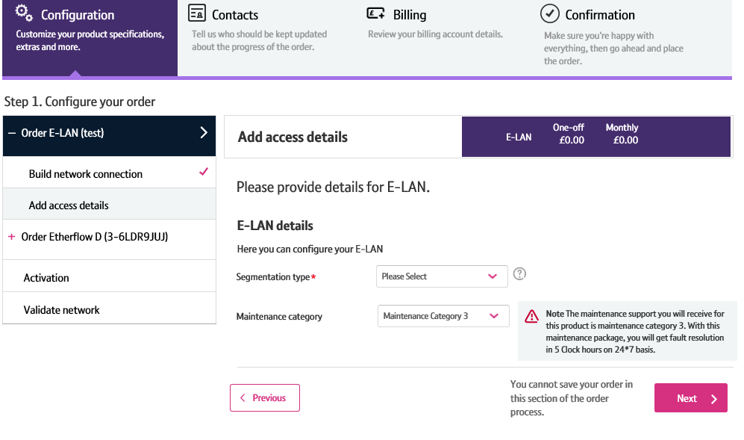
How to place an E-LAN and Etherflow Dynamic order
Step 6: Add access details
Select the segmentation type you require
Click ‘Next’.
Please note: You can’t change the maintenance category option.
1
2

Slide 14
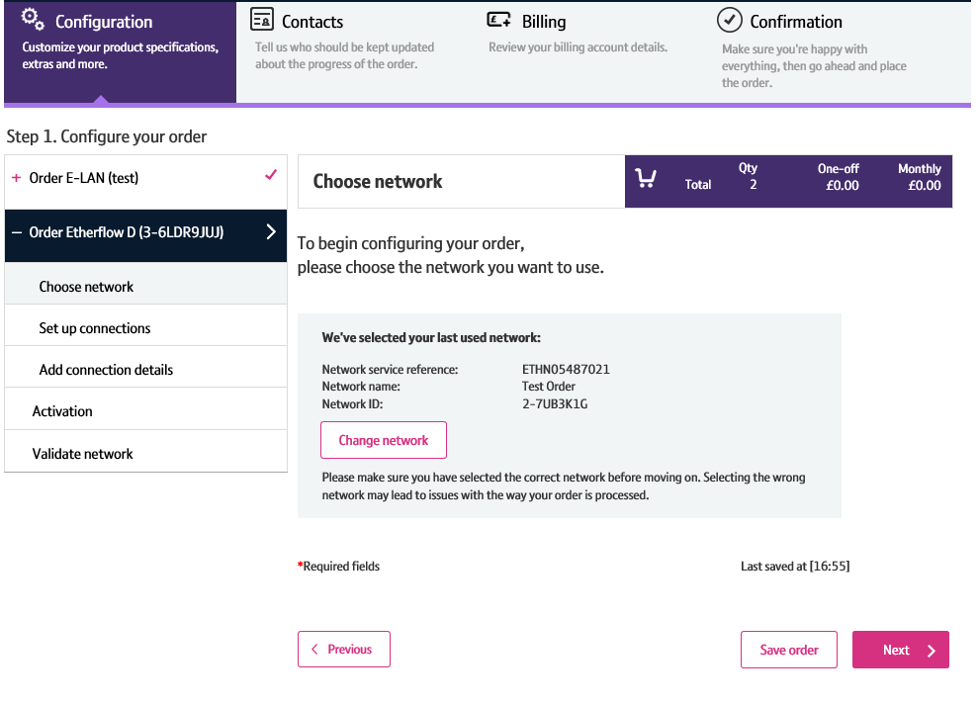
How to place an E-LAN and Etherflow Dynamic order
Step 7: Etherflow Dynamic - Choose a Network
You’ll now need to configure your connecting Etherflow Dynamic.
Your Network will be defaulted to the network you set on your E-LAN. If you wish to change it on your Etherflow Dynamic order, you’ll need to navigate back to your E-LAN order and change it there too as these must match.
Click ‘Next’ to continue.
1

Slide 15
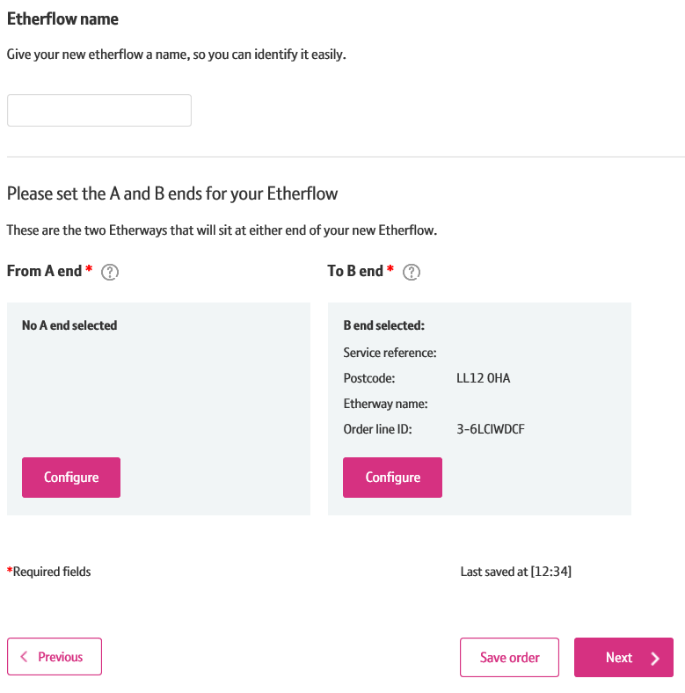
How to place an E-LAN and Etherflow Dynamic order
Step 8: Etherflow Dynamic – Set up connections
You’ll now be required to set up the connections for the service.
You now have the option to give your Etherflow Dynamic a name.
We’ll default the ‘B end’ of your order to the E-LAN you’ve just configured. You can change this if you wish.
You can now set the ‘A end’. Click ‘Configure’
1
2
3

Slide 16
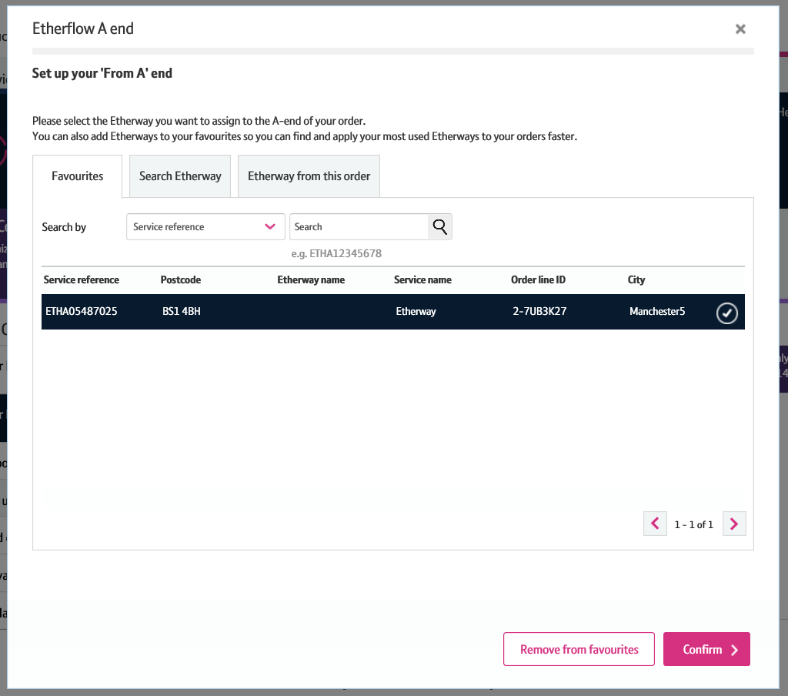
How to place an E-LAN and Etherflow Dynamic order
Step 8: Etherflow Dynamic – Set up connections
Similar to the site contacts, you can save Etherways as favourite A ends so you can easily pick commonly used ones every time you order with us.
Alternatively, you can search manually for an Etherway. But please note, searching by post code can often take a long time to return results, so we recommend you search via service reference.
Once you’ve searched for and selected the Etherway you want to assign to you’re a end, click ‘Confirm’.
1
2
3

Slide 17
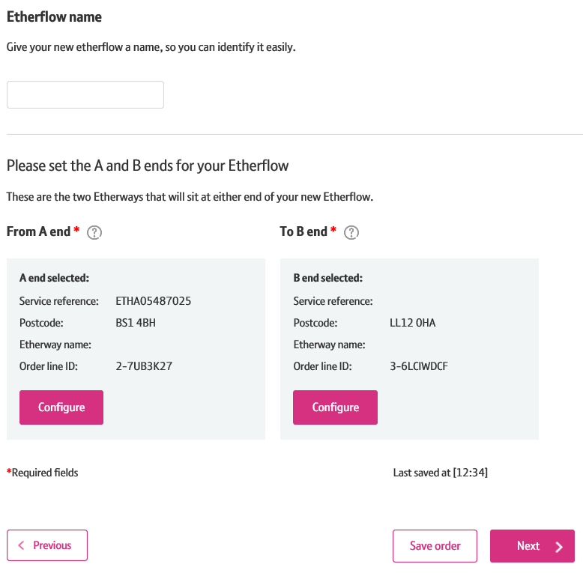
How to place an E-LAN and Etherflow Dynamic order
Step 8: Etherflow Dynamic – Set up connections
Once you have selected the A and B end connections, the details will be displayed on the screen. You can change the details by clicking ‘Set end’ again.
Once you’re happy the details are correct, click ‘Next’ to continue.
1
2

Slide 18
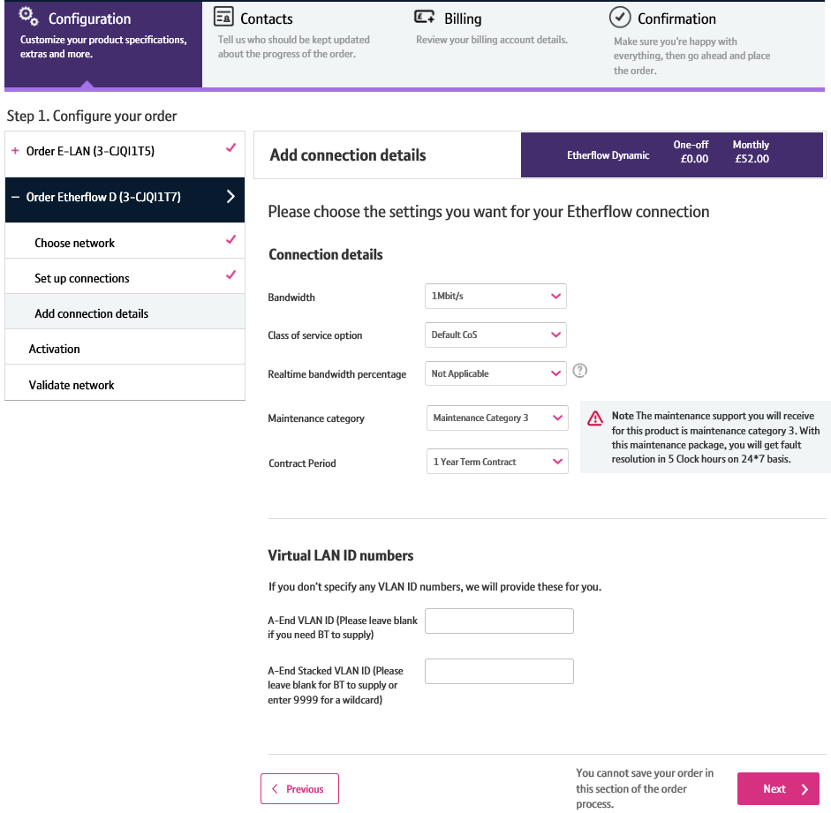
How to place an E-LAN and Etherflow Dynamic order
Step 9: Etherflow – Add Connection Details
You’ll now need to configure your Etherflow Dynamic further.
In the ‘Connection Details’ section, you can specify the Etherflow Dynamic bandwidth, class of service, real time bandwidth percentage and contact period. You can’t amend the maintenance category option.
You can specify the VLAN ID you wish to use here. If you leave this blank, we’ll supply a VLAN ID for your order.
Click ‘Next’ to continue.
1
2
3

Slide 19
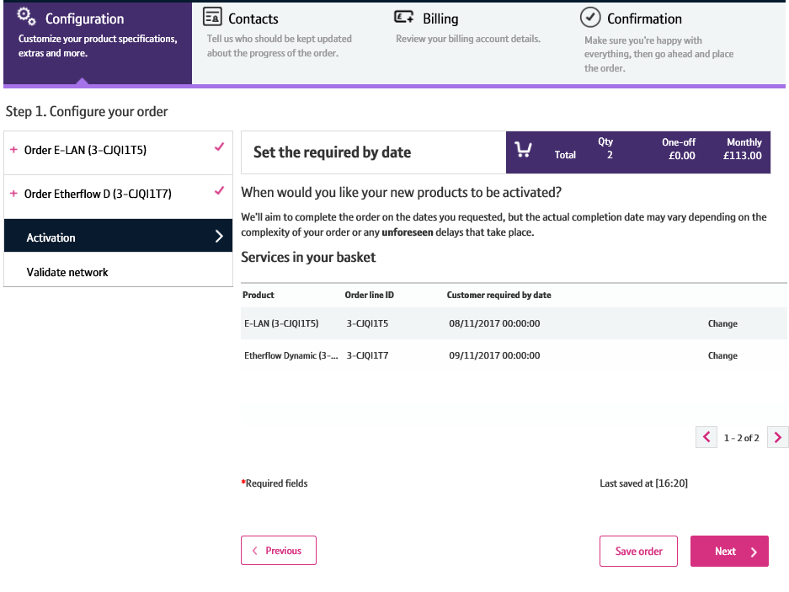
How to place an E-LAN and Etherflow Dynamic order
Step 10: Set the Activation Date
You’ll now set the ‘Customer Required by Date (CRD)’.
It’ll be defaulted to the standard minimum lead time.
If you wish to change the CRD, you can do so by clicking ‘Change’.
2. Click ‘Next’ to continue.
1
2

Slide 20
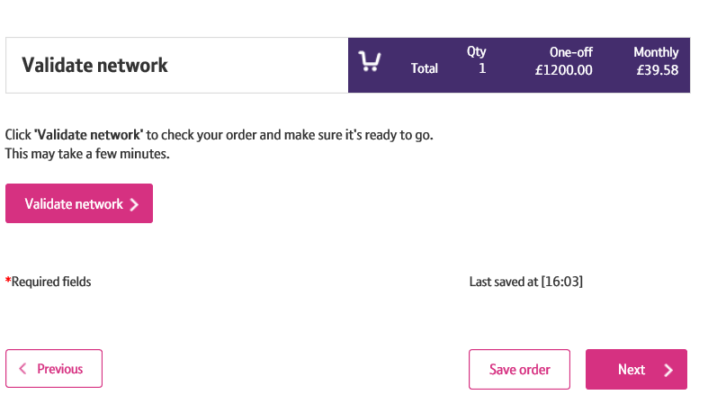
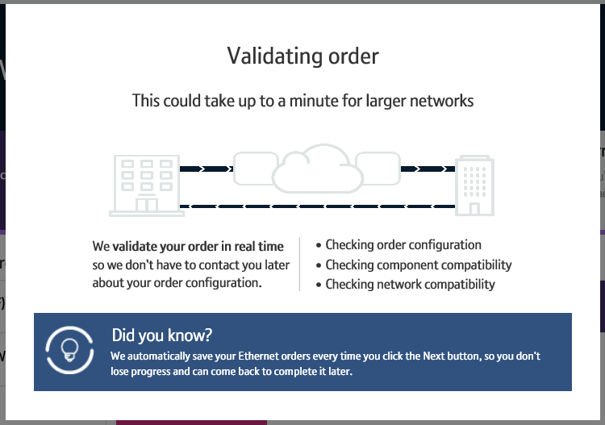
How to place an E-LAN and Etherflow Dynamic order
Step 11: Validate Network
Next, you’ll need to perform a ‘Validate Network’ check.
This will check that your network can support the configuration of the order.
This check will take longer the bigger your network is.
Click ‘Validate Network’.
1

Slide 21
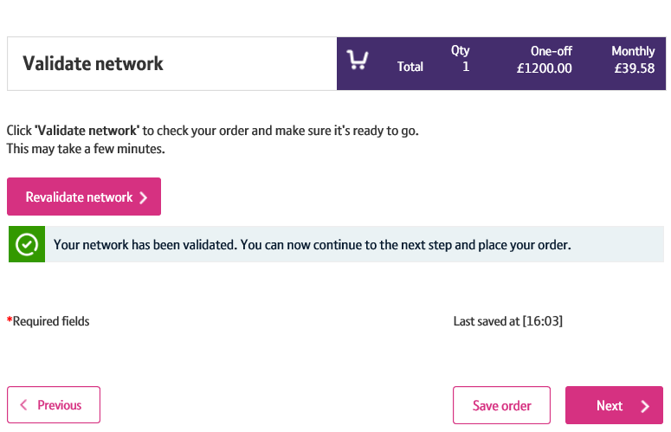
How to place an E-LAN and Etherflow Dynamic order
Step 11: Validate Network
The validation result will be displayed.
Click ‘Next’ to continue.
Please Note: If validation fails, you can make the relevant changes and re-validate.
1
2

Slide 22
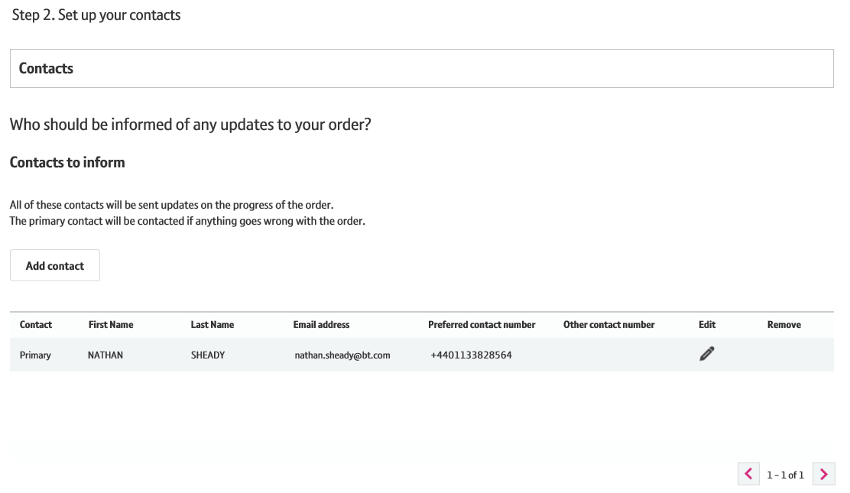
How to place an E-LAN and Etherflow Dynamic order
Step 12: Set up your contacts
In this step, you can add and choose contacts who wish to be kept up to date with the order progress.
We default the contact details to the account issuing the order.
You can add a contact by clicking ‘Add Contact’.
Or you can edit the existing contact by clicking ‘Edit’.
1
2

Slide 23
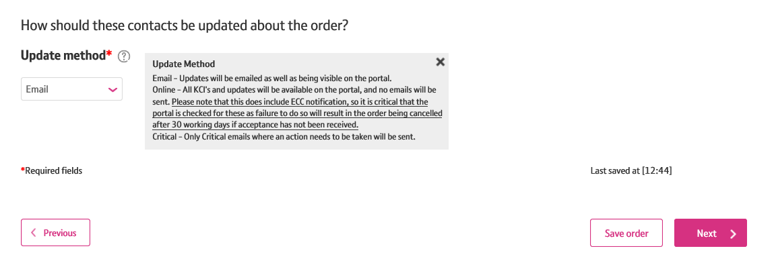
How to place an E-LAN and Etherflow Dynamic order
Step 12: Set up your contacts
You can select how you would like to be kept up to date via the ‘Update Method’ dropdown.
Once you are happy that all the contact details are entered correctly, click ‘Next’ to continue.
1
2

Slide 24
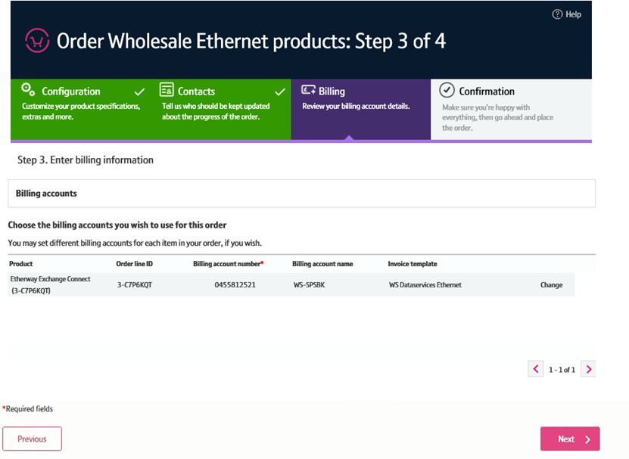
How to place an E-LAN and Etherflow Dynamic order
Step 13: Billing
In this section you can select the billing account associated with the order.
The billing account details will be auto –populated. But you have the option to change them if you wish.
Click ‘Next’ to continue.
1
2

Slide 25
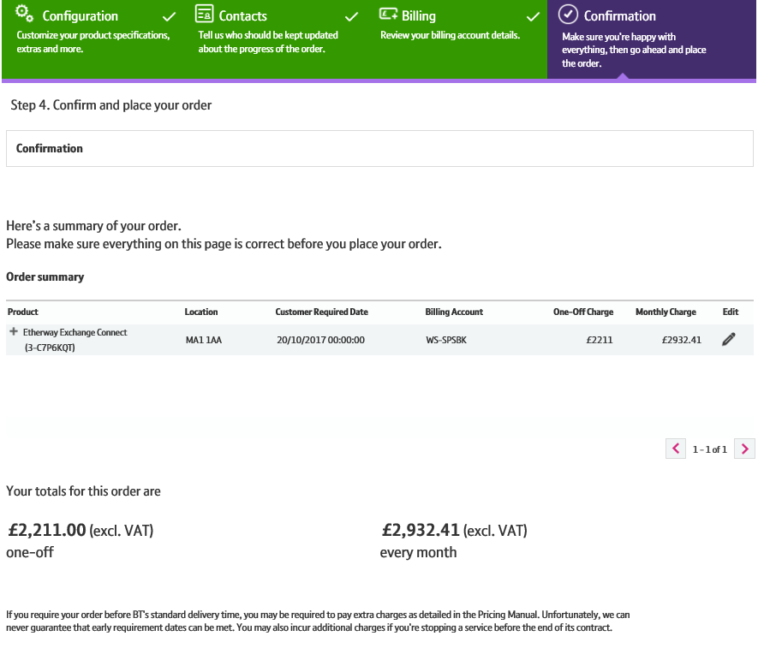
How to place an E-LAN and Etherflow Dynamic order
Step 14: Confirmation
The confirmation page gives you a summary of the order.

Slide 26
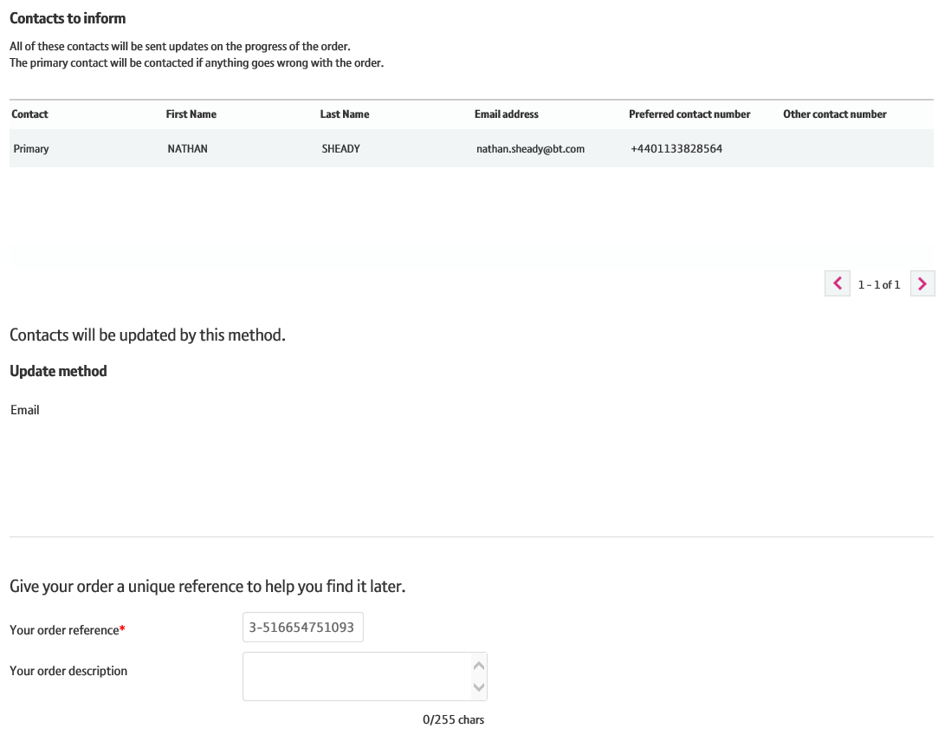
How to place an E-LAN and Etherflow Dynamic order
Step 14: Confirmation
Update method is shown.
You are required to enter a reference for the order. We default this to the order number, but you can overwrite this with your own reference and add a description if you wish.
1
2

Slide 27
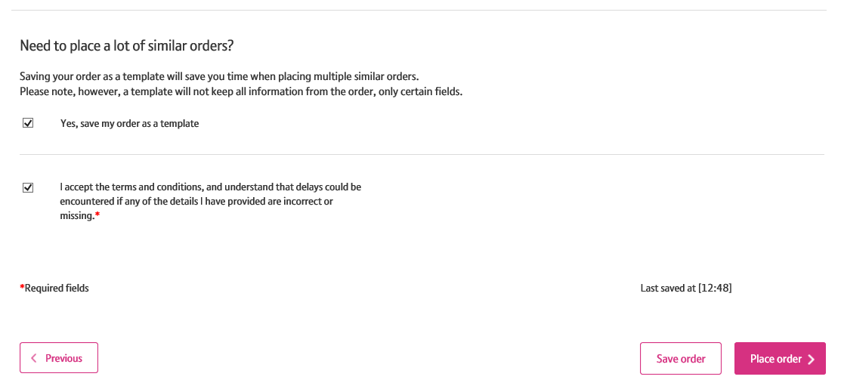
How to place an E-LAN and Etherflow Dynamic order
Step 14: Confirmation
If you wish to save your order as a template, tick the relevant checkbox.
Then, click the confirmation checkbox.
Click ‘Place Order’ to enter the order.
1
2
3

Slide 28
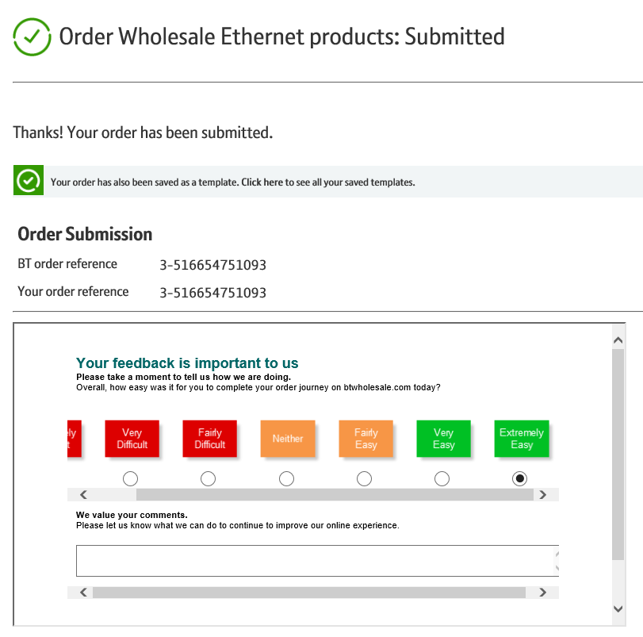
How to place an E-LAN and Etherflow Dynamic order
Step 14: Confirmation
You’re order has now been placed!
We’ll send you confirmation of your order details via email in addition to showing them on the screen.
If you want to comment on the journey, or wish to provide feedback such as suggestions for improvements, you can do so via the feedback section.

