Slide 1

Business Zone Ethernet – Saving an Order as a Template
BT Wholesale Online
V3
LEGAL NOTICE: The information contained in this briefing is confidential information as per your terms and conditions with BT. Please do not forward, republish or permit unauthorised access. The content is accurate at the time of writing and is subject to change.

Slide 2
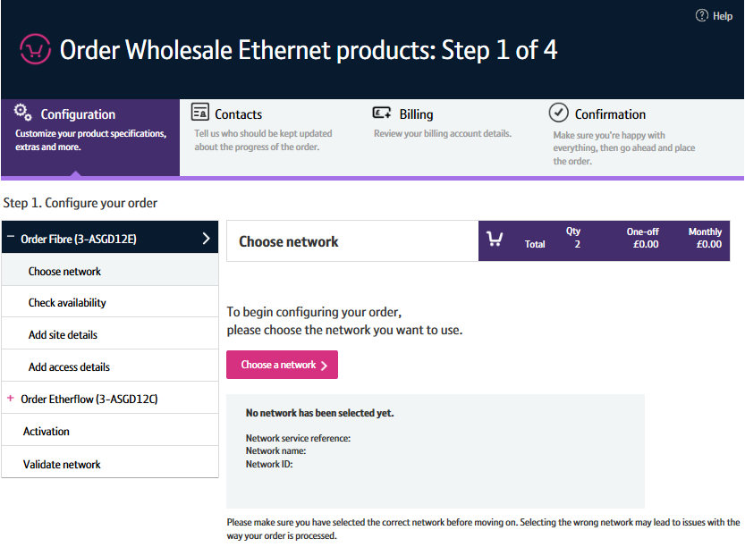
Contents
What’s in this User Guide?
p3 - Pre-requisites
p4 – Save order as template

Slide 3
Version Control
Date | Change | Version
14/11/16 | User Guide Published. | 1
16/01/16 | Updated to include new available journeys (linked to Transformed Ethernet Ordering page) | 2
30/04/18 | Re-branded | 3

Slide 4
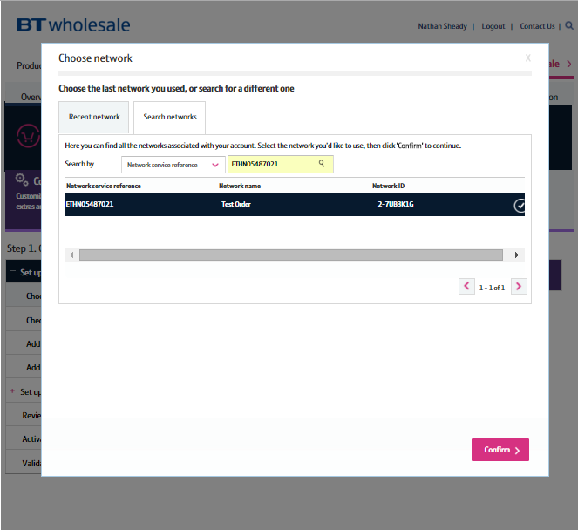
Pre-Requisites
What do you need to enter an Ethernet order via the new journey?
You need correct access and privileges, including My BT Wholesale (Business zone). If you don’t have this, please contact your company administrator to action
The journey is currently only available to enter orders based on specific combinations of Etherway Fibre, Etherway Copper and Etherflow Connect. Please visit our Transformed Ethernet Ordering page to learn more
You must be using a Windows machine and using the latest version of Internet Explorer, Chrome or Firefox
Mobile devices, Mac and Safari are not supported

Slide 5
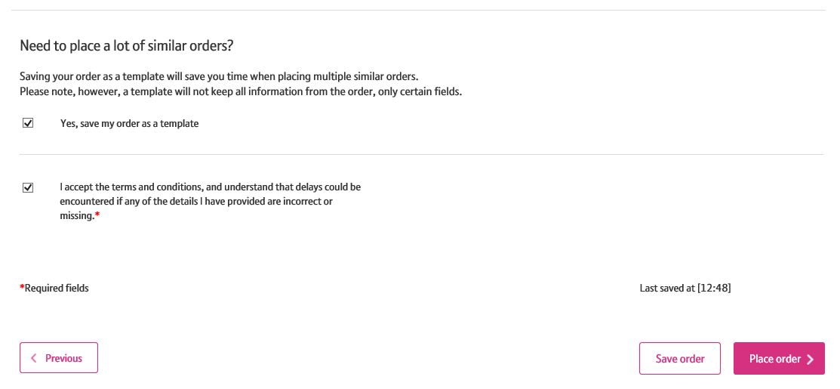
Save Order as Template
Introduction to saving an order as a template
When entering an order journey, you are given the option to ‘save your order as a template’ on the confirmation screen.
This allows you to save the way you’ve configured your order so you can use it again, saving you time.
All your configuration will be saved except from the details that are unique to the order e.g. site address.
If you have any templates saved, you’ll see ‘My Ethernet Templates’ link on My BT Wholesale (Business Zone).

Slide 6
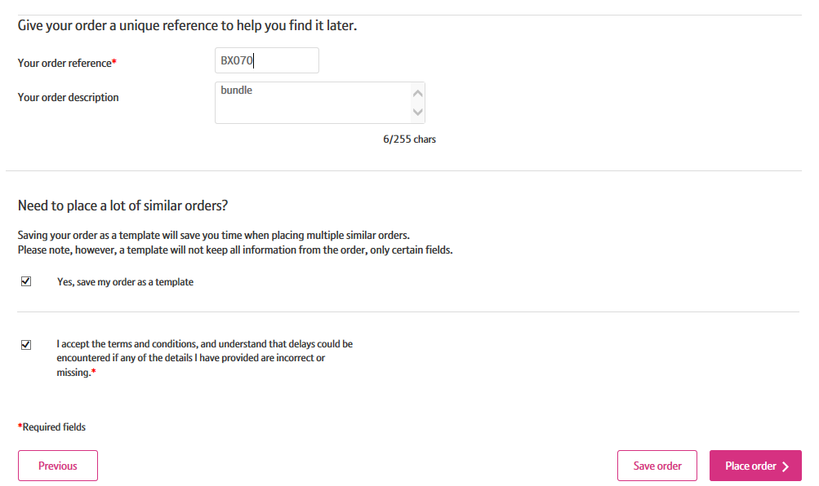
Save Order as Template
Step 1: Saving the template
When placing an order, on the confirmation screen you’ll have the option to save the order as a template.
When ordering, you’ll need to give your order a reference. This will also be used to identify your template
Select the ‘Yes, save my order as a template’ checkbox
Place your order
1
2
3

Slide 7
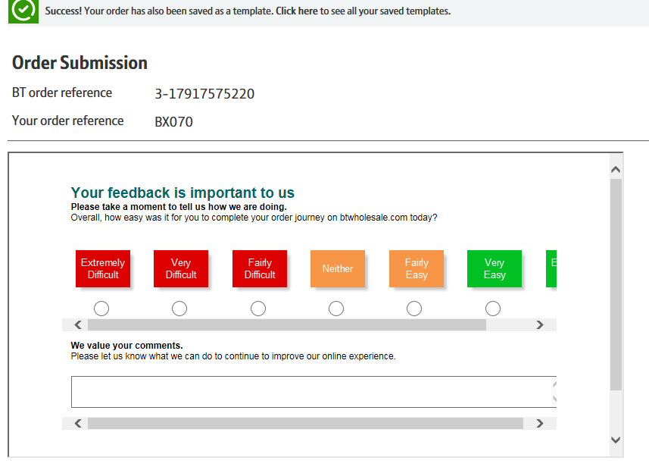
Save Order as Template
Step 1: Saving the template
You’ll be told that the order has been saved as a template on the order submission screen

Slide 8
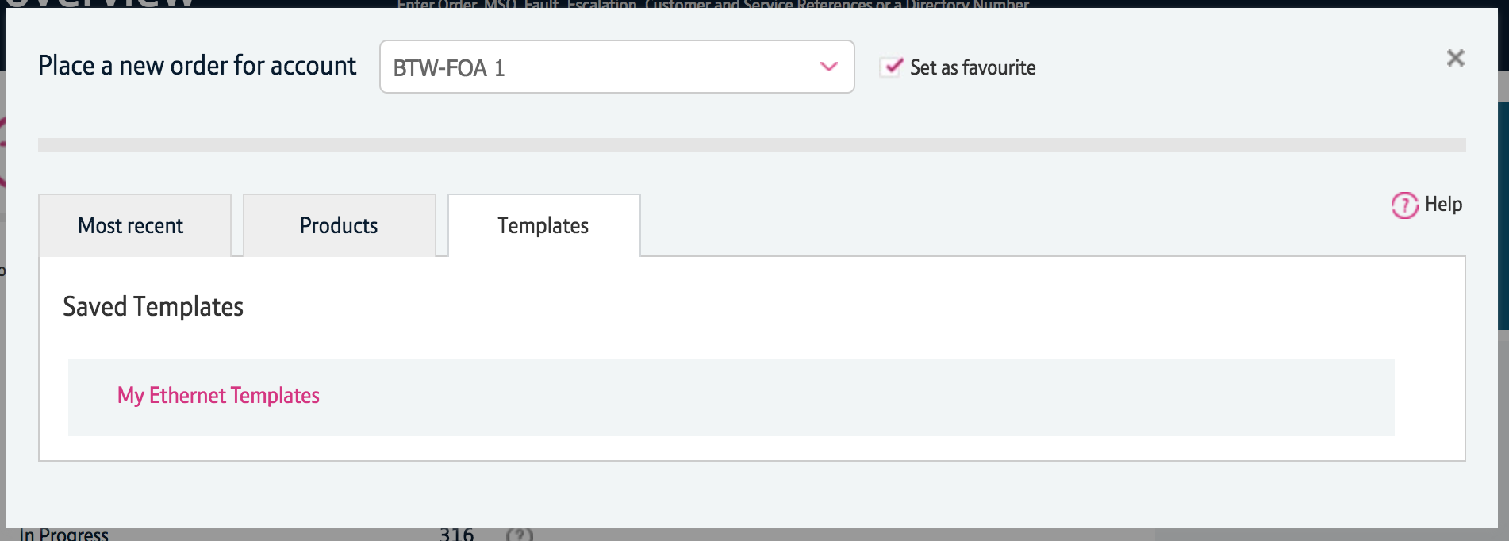
Save Order as Template
Step 2: Retrieving a saved template
To retrieve a template, once you’ve clicked ‘Place a new order’ on Business Zone, you’ll see ‘Templates’ in the tab section of the widget.
Click the ‘Templates’ tab
Click ‘My Ethernet Templates’

Slide 9
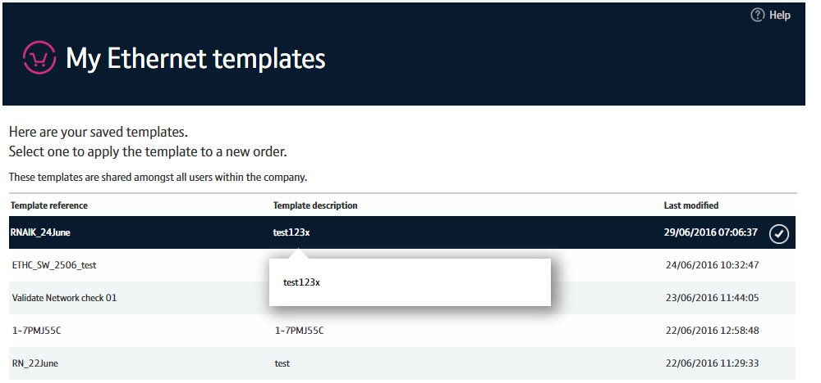
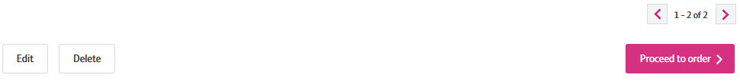
Save Order as Template
Step 2: Retrieving a saved template
Here you’ll see a list of your saved templates.
Click on the template you wish to use from the list
You can edit or delete the template if you wish
If you want to apply the selected to an order, click ‘Proceed to order’
You’ll then be taken to the order in the new journey where your configuration will be populated.
1
2
3

