Slide 1

Business Zone Ethernet – Saving an Order
BT Wholesale Online
V3
LEGAL NOTICE: The information contained in this briefing is confidential information as per your terms and conditions with BT. Please do not forward, republish or permit unauthorised access. The content is accurate at the time of writing and is subject to change.

Slide 2
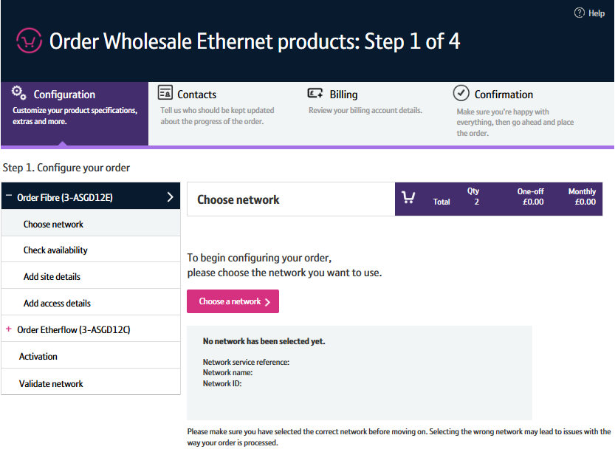
Contents
What’s in this User Guide?
p4- Pre-requisites
p5 – Saving an Order

Slide 3
Version Control
Date | Change | Version
14/11/16 | User Guide Published | 1
16/01/16 | Updated to accommodate new journeys | 2
30/04/18 | Re-branded | 3

Slide 4
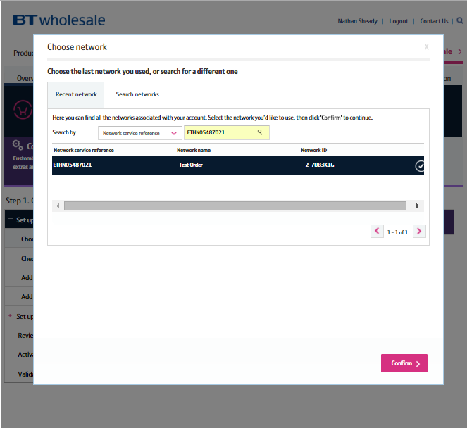
Pre-Requisites
What do you need to enter an Ethernet order via the new journey?
You need correct access and privileges, including My BT Wholesale (Business zone). If you don’t have this, please contact your company administrator to action
The journey is currently only available to enter orders based on specific combinations of Etherway Fibre, Etherway Copper and Etherflow Connect. Please visit our Transformed Ethernet Ordering page to learn more
You must be using a Windows machine and using the latest version of Internet Explorer, Chrome or Firefox
Mobile devices, Mac and Safari are not supported

Slide 5
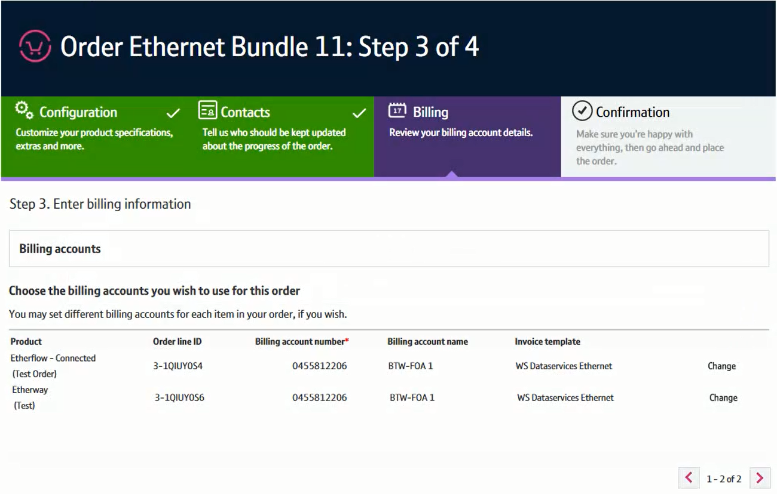

Saving an Order
Step 1: Save Order
Your order will automatically be saved on each order screen. This allows you to save the way you’ve configured the order up to that point, so you can retrieve and continue with the order placement at a later date/time.
The order will be saved for 90 days. After which, the record will be deleted from our systems.
If you wish to save an order manually:
Click ‘Save Order’
1
1

Slide 6
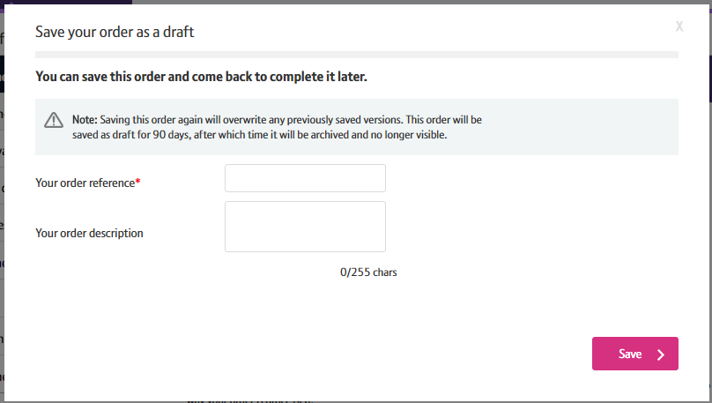
Saving an Order
Step 1: Save Order
Enter a reference and description for the order
Click ‘Save’
1
2

Slide 7
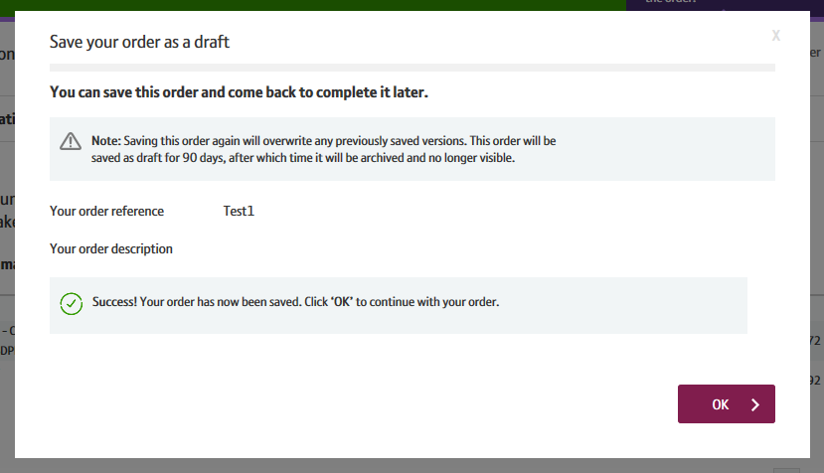
Saving an Order
Step 1: Save Order
A success message will now be displayed.
Click ‘OK’ to continue with the order entry if you wish
1

Slide 8
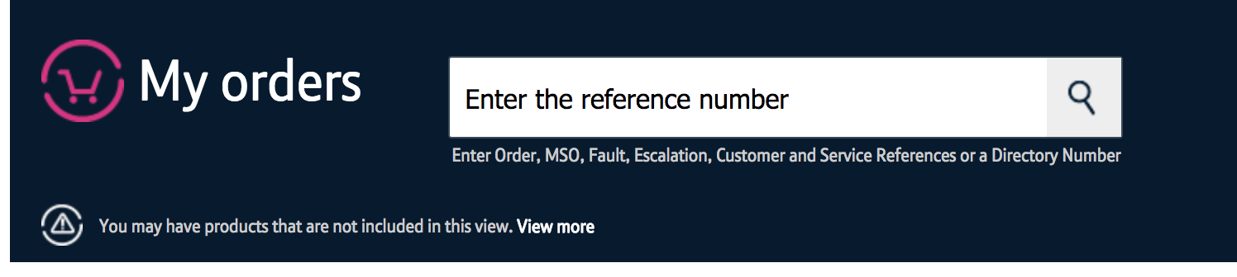
Saving an Order
Step 2: Retrieving a Saved Order
You can retrieve a saved order via Business Zone.
Please Note: It can take up to 5 minutes before the saved order is searchable on Business Zone.
You can search for the saved order different ways in Business Zone, but the quickest way is using the Search facility.
Enter the search criteria (Save Order Reference) in the search bar. Click on the magnifying glass.
1

Slide 9
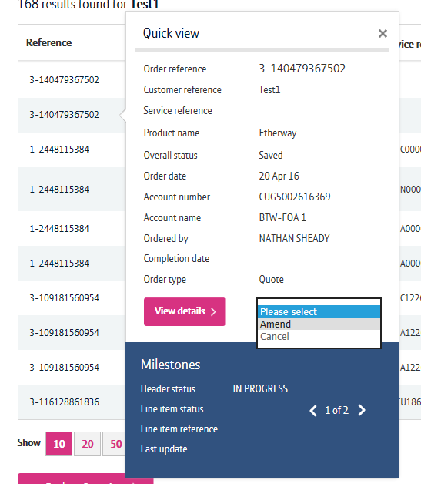
Saving an Order
Step 2: Retrieving a Saved Order
Click on the ‘Reference’ field to open the Quick View
Select ‘Amend’ from the dropdown
You will now be taken to the area where you can finish entering your order.
1

